Slide 1
Tom Walkinshaw
Alba Orbital update

Slide 2
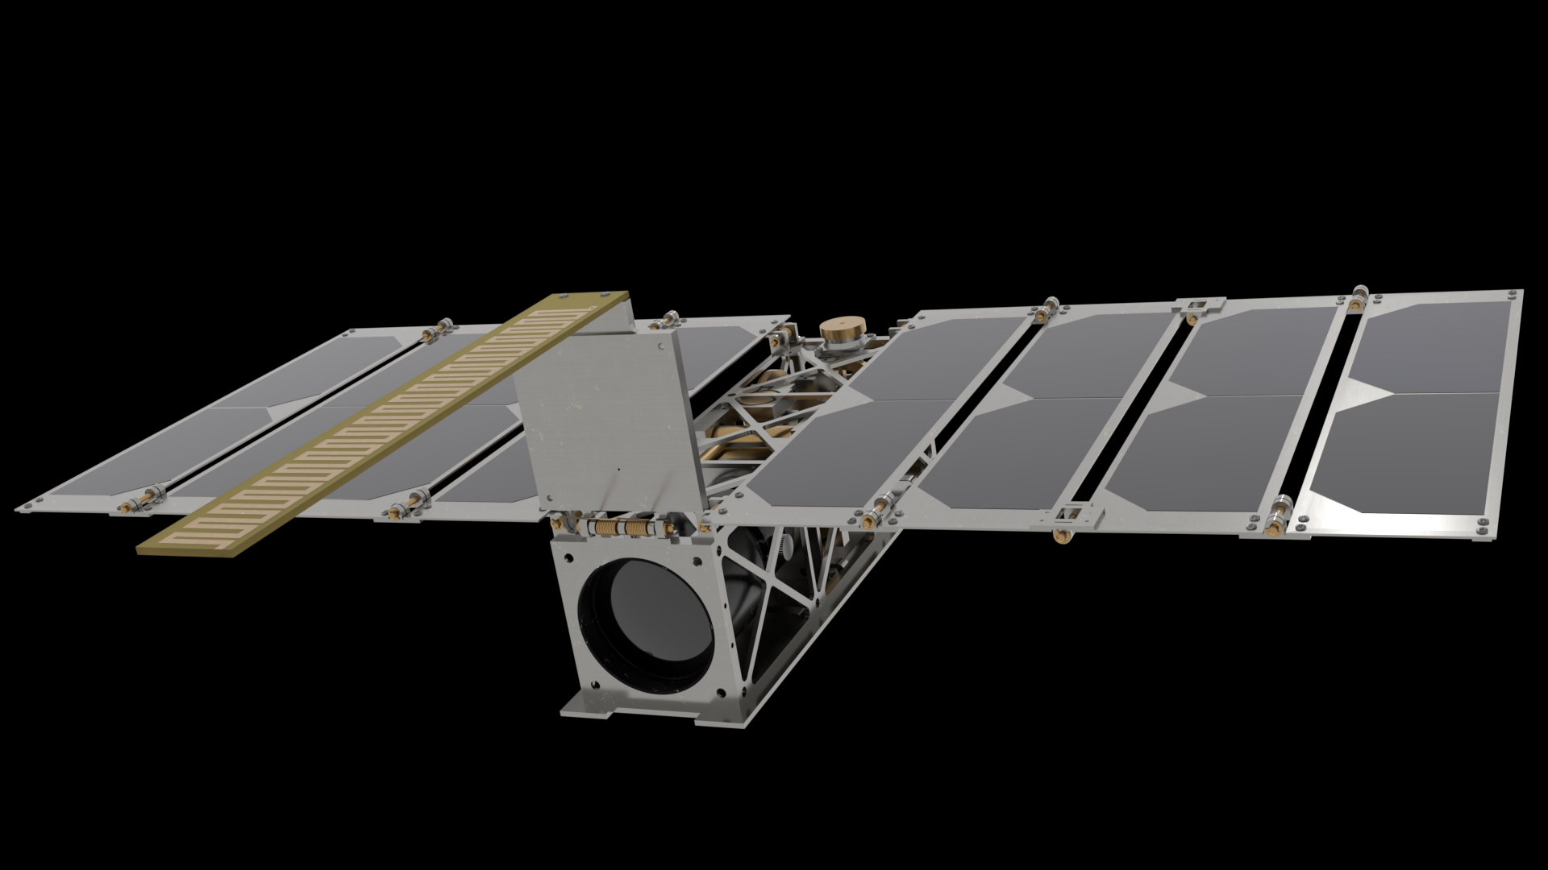
Mission Statement of Alba
Alba Orbital’s mission is to advance the PocketQube cause. Our goal is to be the best PocketQube company in the world and for that to matter.

Slide 3
3 stage plan for Alba
Stage 1 Launch Clusters - Albalaunch
Stage 2 Platforms - Unicorn-2
Stage 3 Mini Constellation - Niche data market

Slide 4
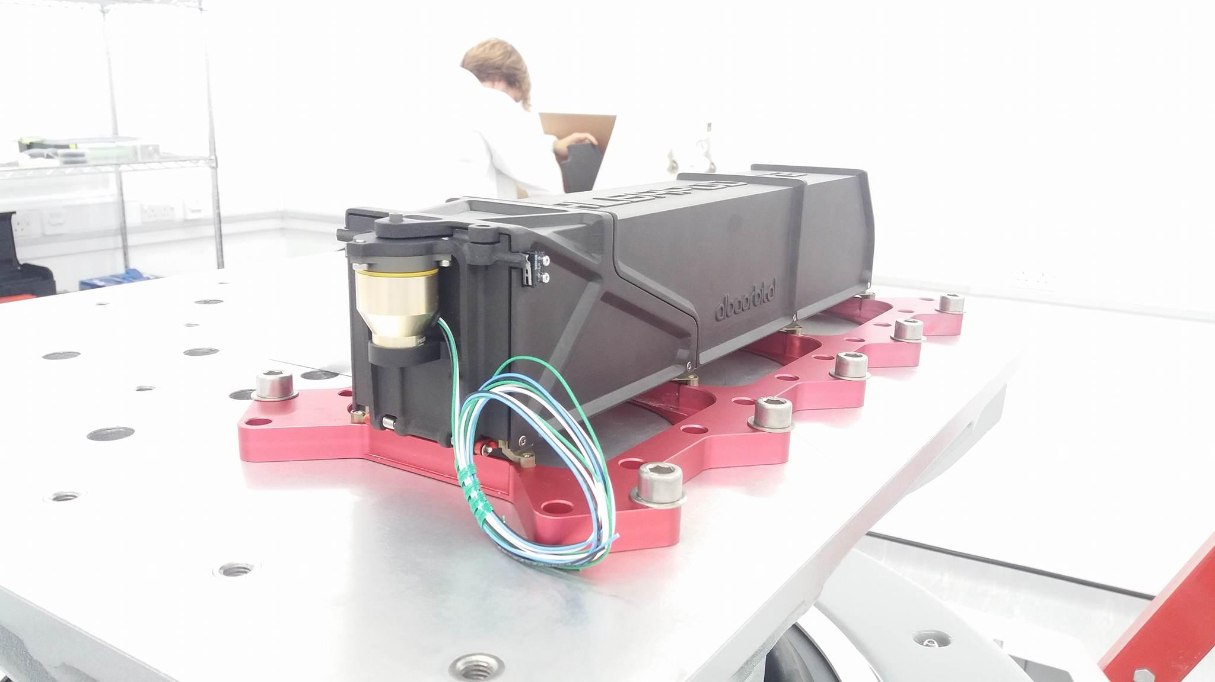

Slide 5
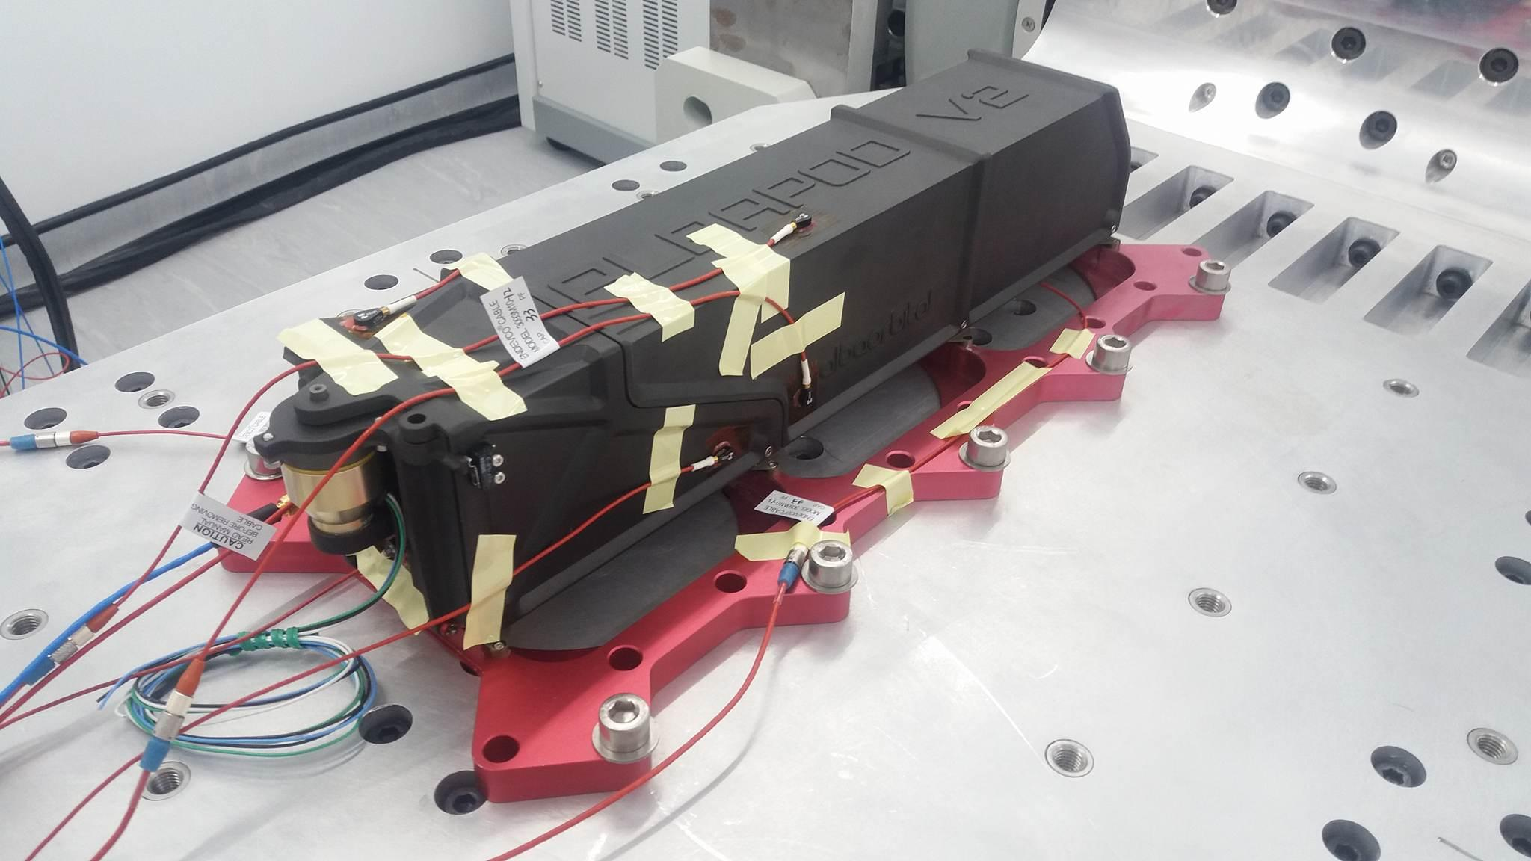
Albalaunch

Slide 6
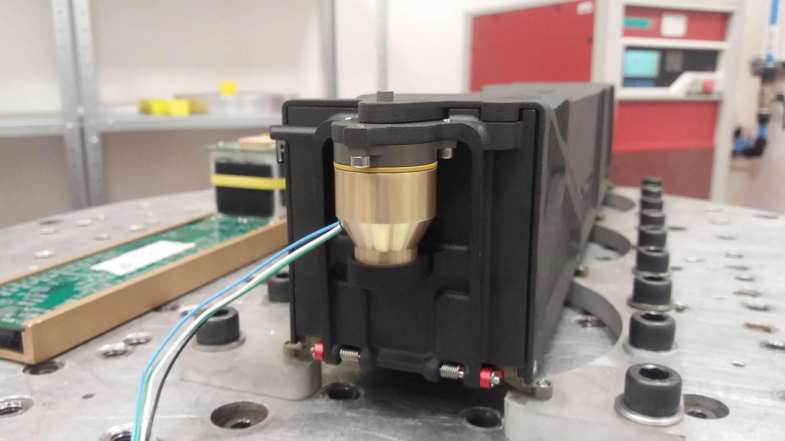

Slide 7
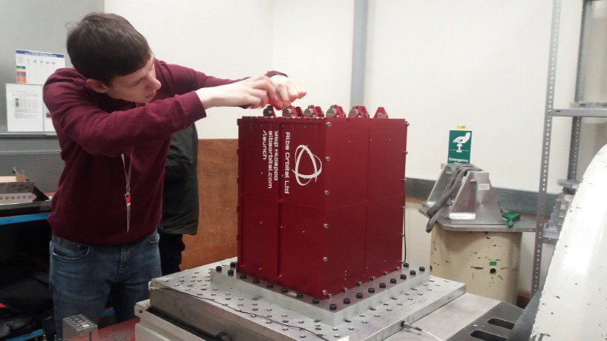

Slide 8
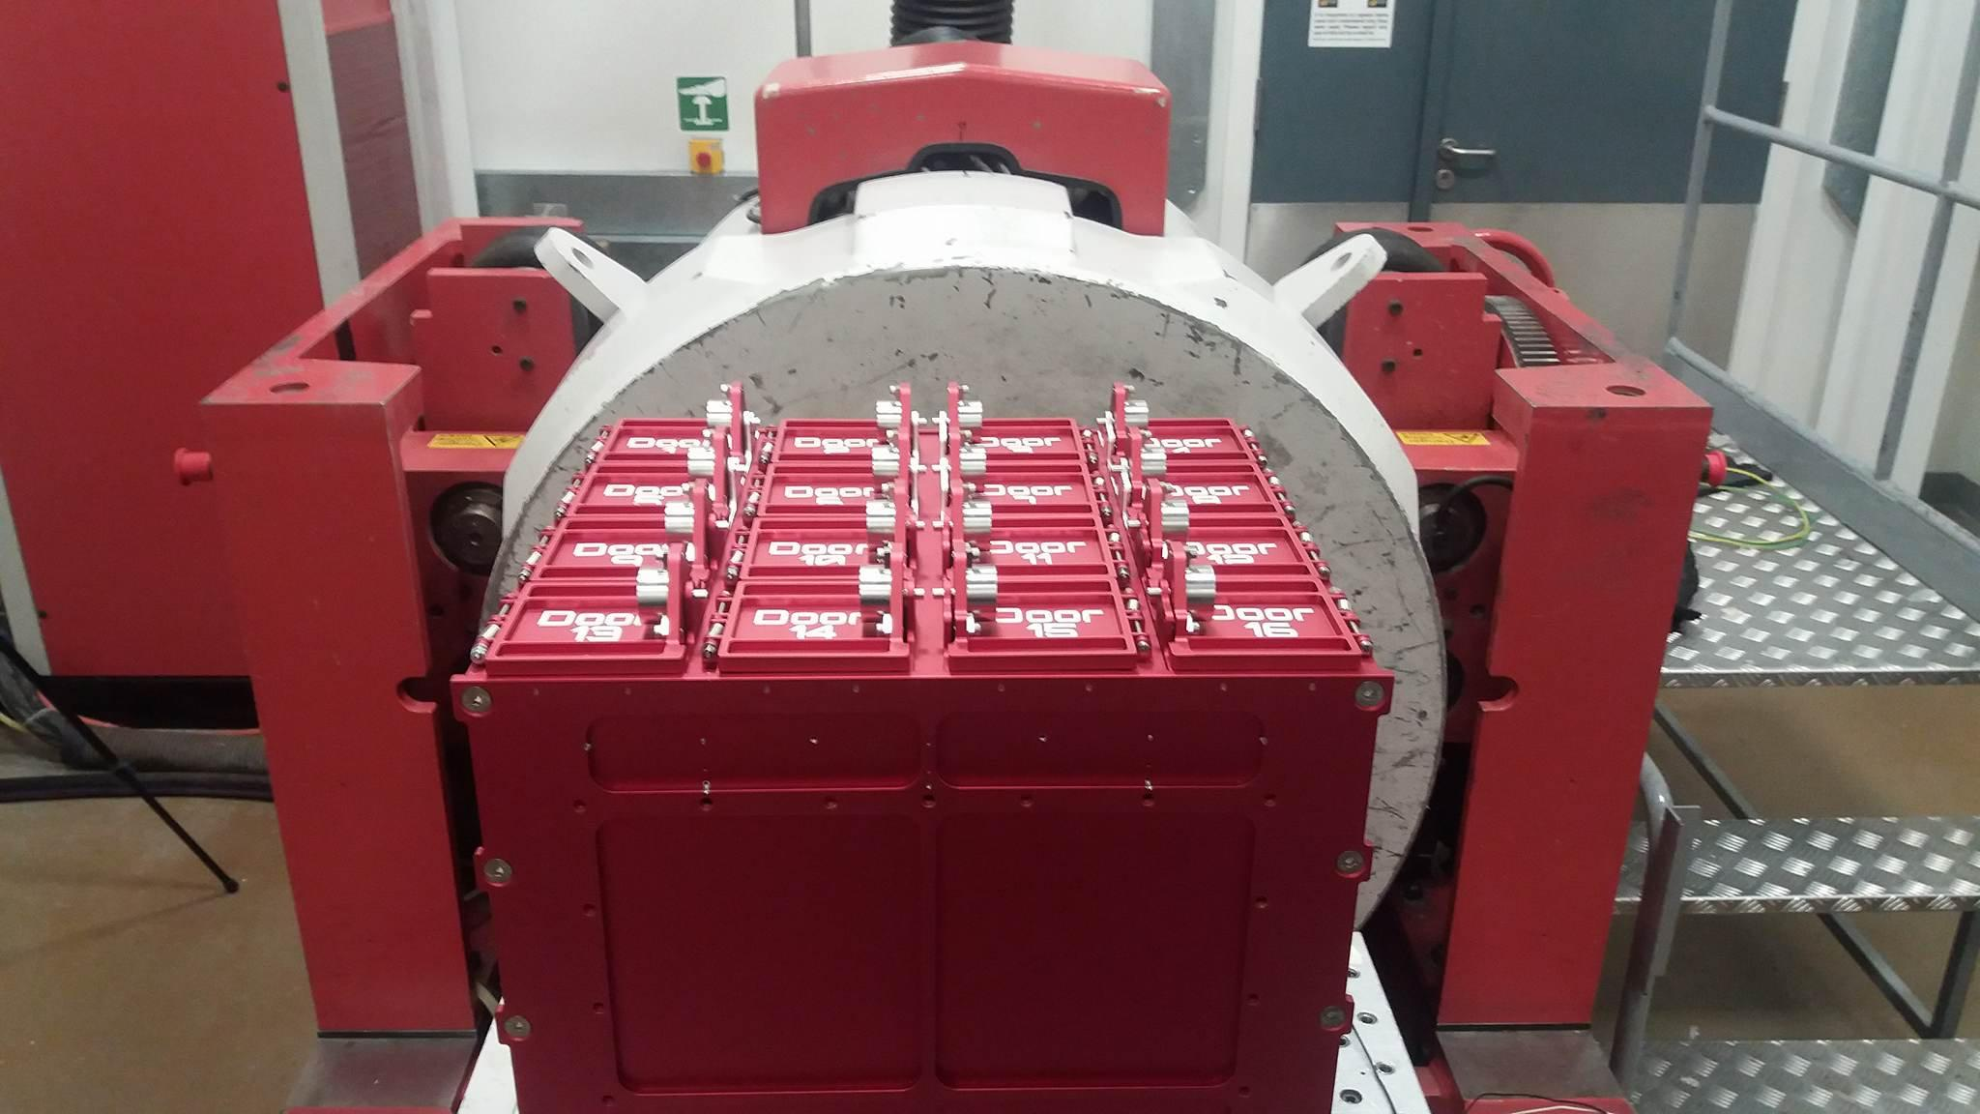

Slide 9
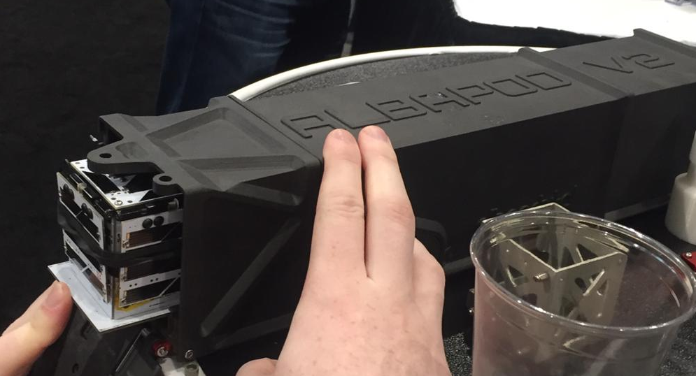
Launch Team Update
  Pod 1 Cluster 2 Integration 9th of September

Slide 10
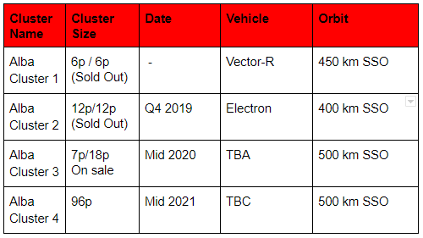
Alba Launch

Slide 11
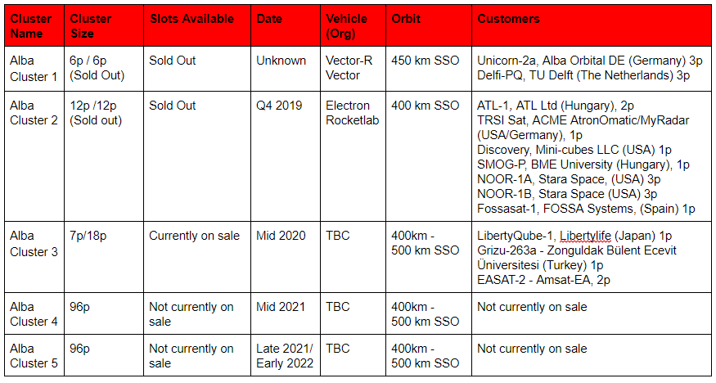
Alba Manifest

Slide 12
Alba Launch Pricing

Slide 13
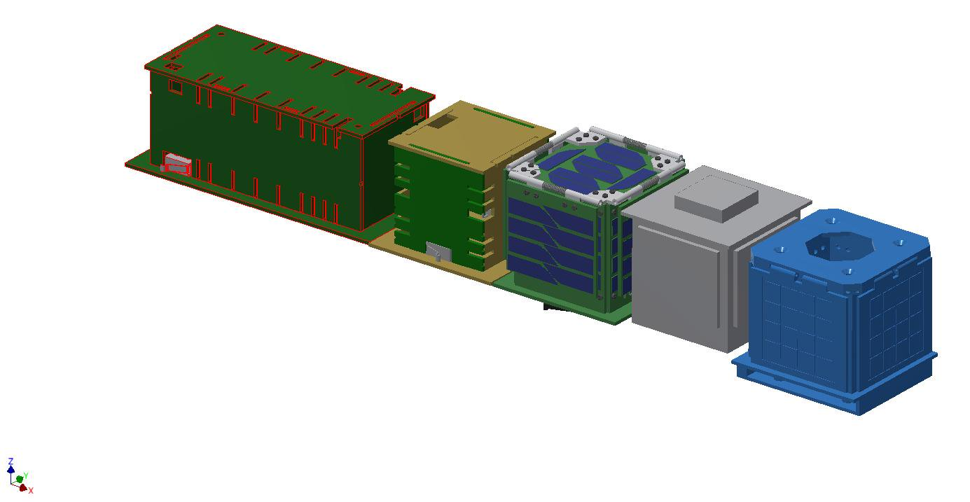

Slide 14
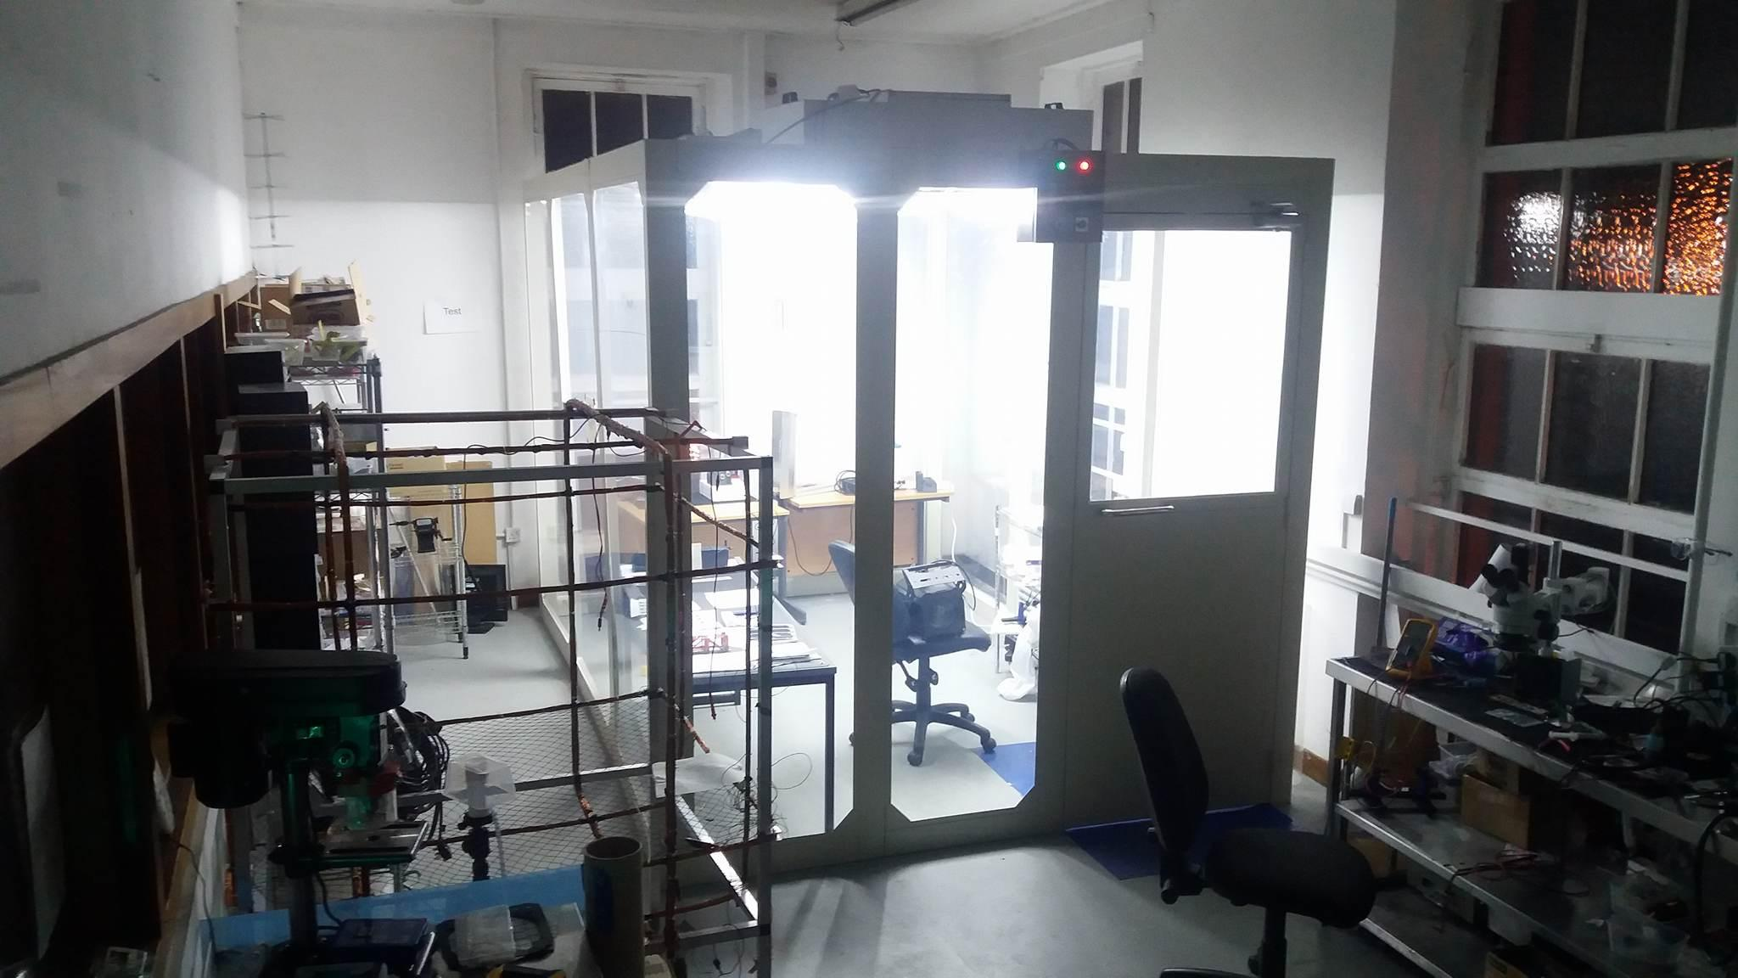

Slide 15
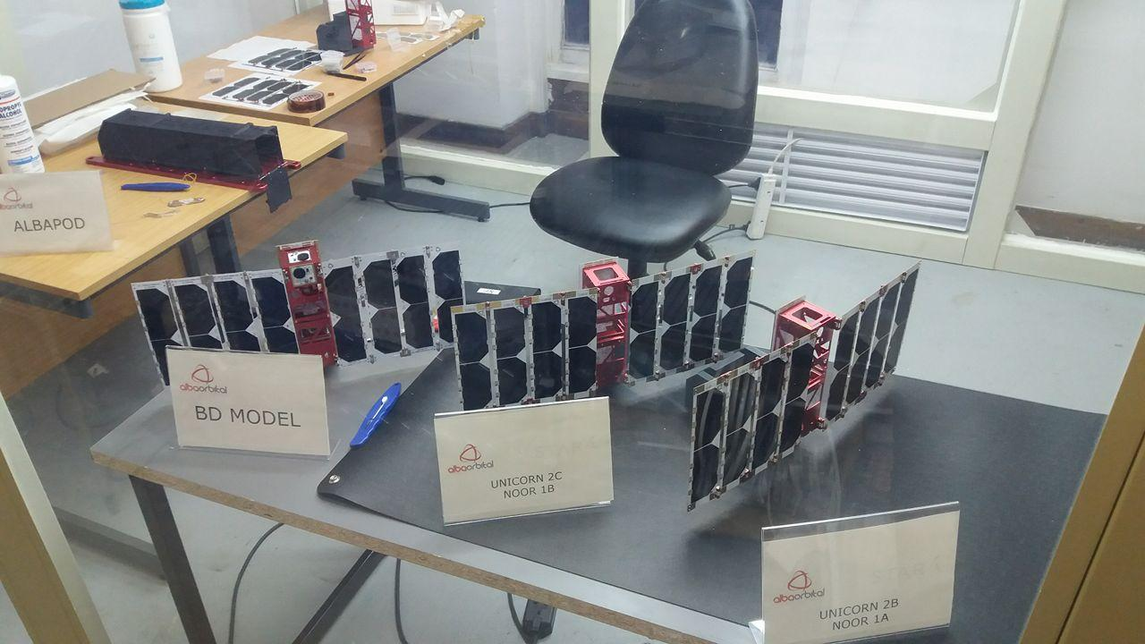

Slide 16
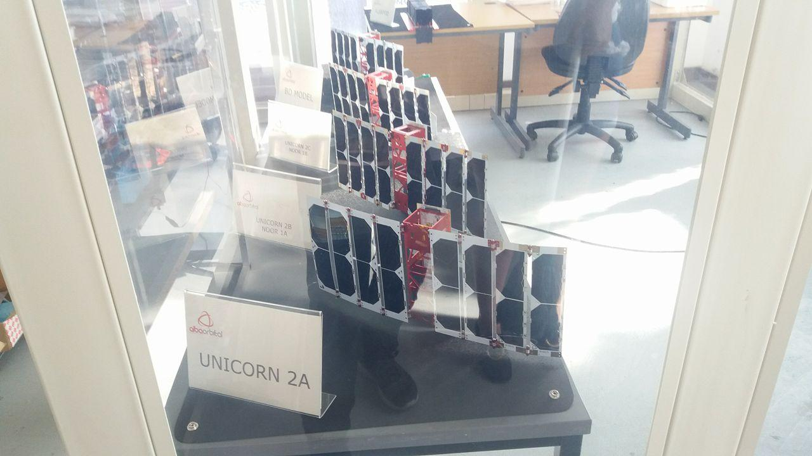

Slide 17
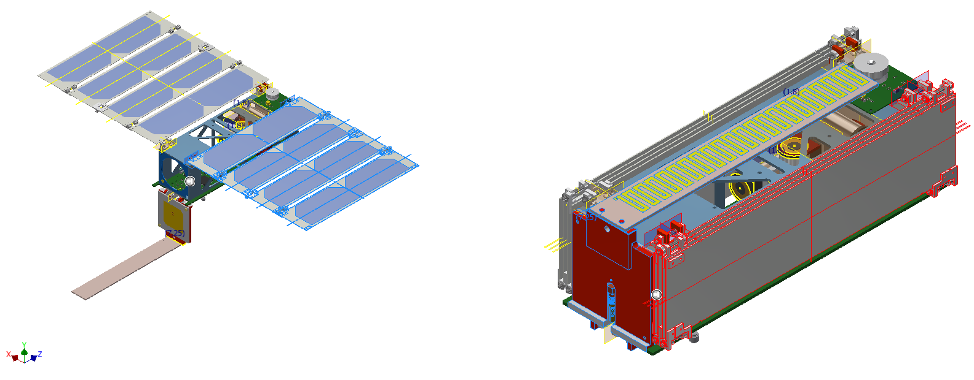

Slide 18
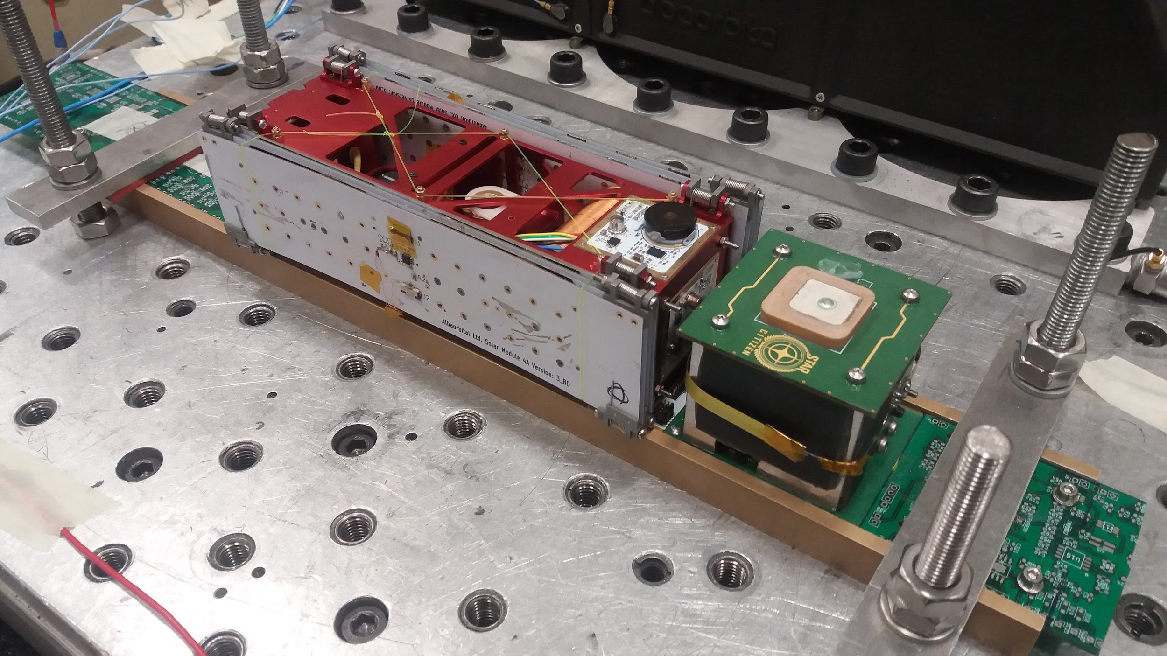

Slide 19
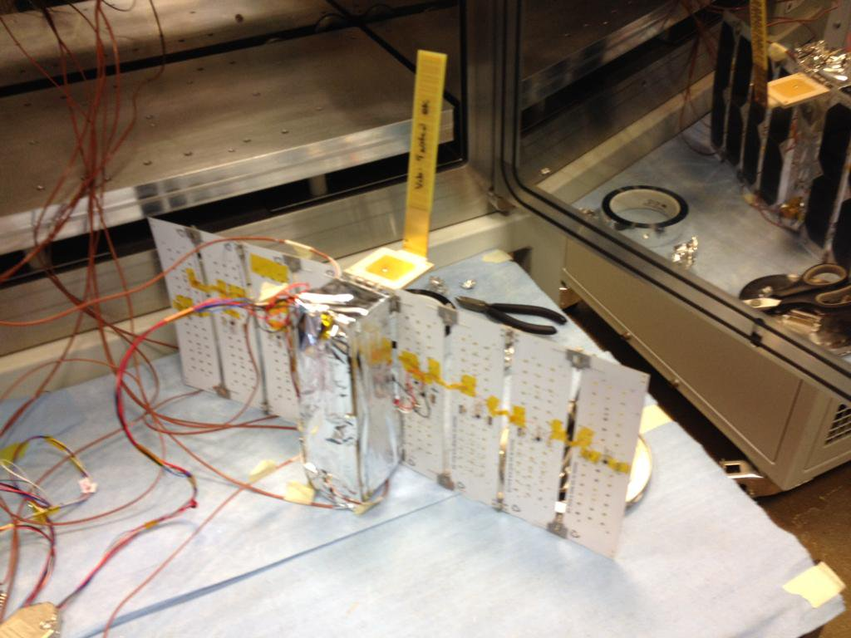

Slide 20
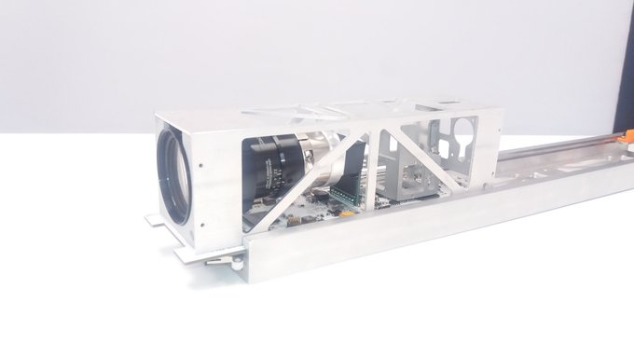
Unicorn - 2a, Earth Observation Tech Demo

Slide 21
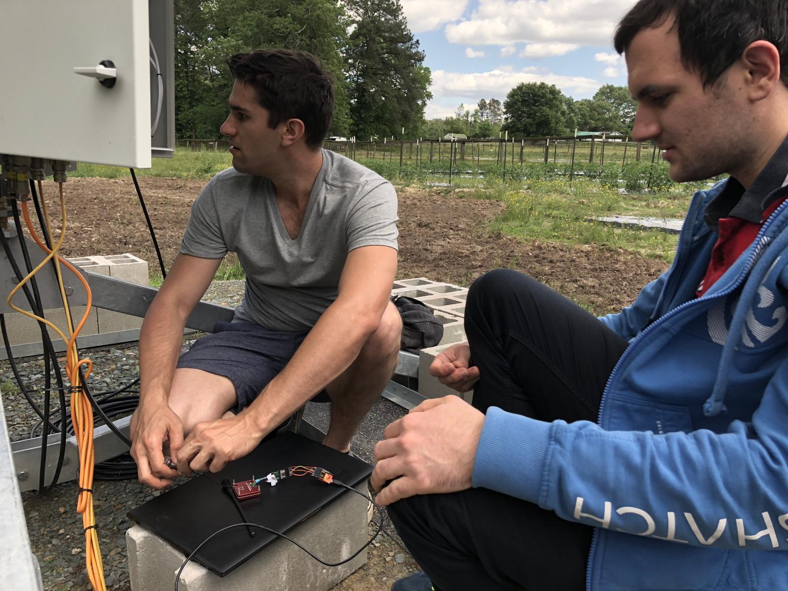
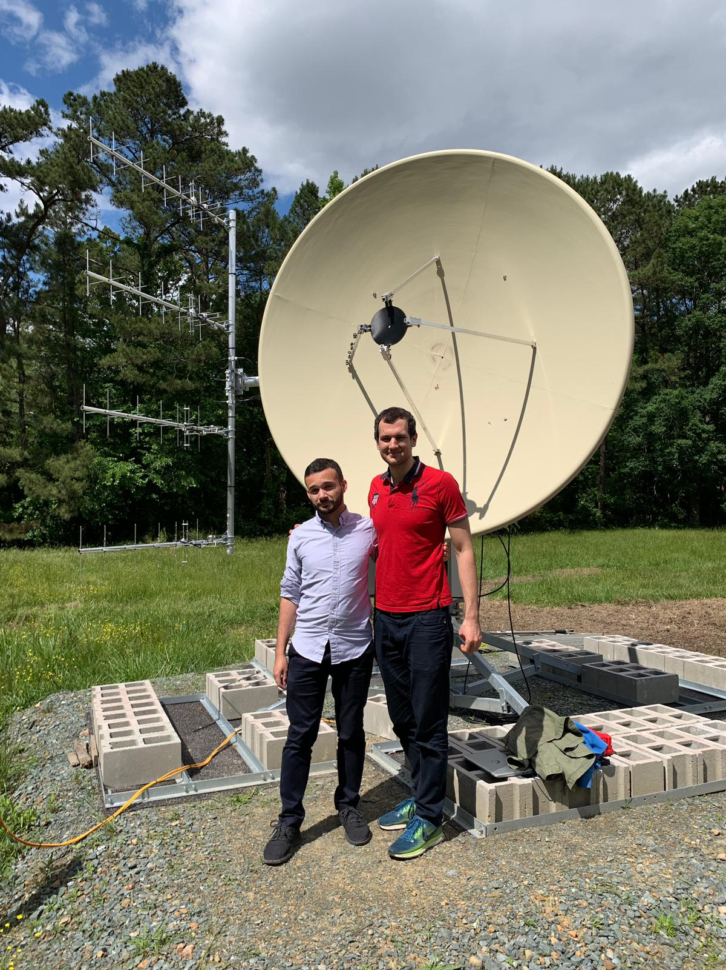
Stara Unicorn-2b/2c customer

Slide 22
Unicorn Production
1 per month target in 2019
Quotes out for Unicorn-2D, E, F

Slide 23
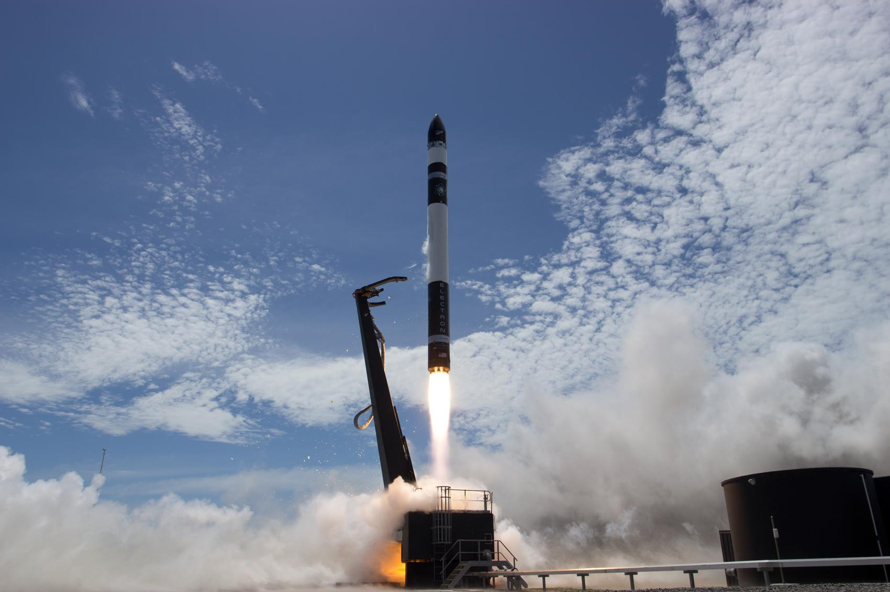

Slide 24
Thank you!
Questions

