Slide 1


PocketQube Workshop 2019
Oriol cortés, Aerospace engineering student. Universidad europea de Madrid
oriolcortes1995@Gmail.com

Slide 2
Project Description

Slide 3
Project Description
Made by UEM Undergrad Students and AMSAT EA Radio Amateurs

Slide 4
Project Description
Made by UEM Undergrad Students and AMSAT EA Radio Amateurs
Low Earth Orbit satellite for voice communications
  Intended for FM handheld transceivers

Slide 5
Project Description
Made by UEM Undergrad Students and AMSAT EA Radio Amateurs
Low Earth Orbit satellite for voice communications
  Intended for FM handheld transceivers
PocketQube 2P 5x5x11.4cm + Base Plate (PocketQube Standard Issue 1)

Slide 6
Project Description
Made by UEM Undergrad Students and AMSAT EA Radio Amateurs
Low Earth Orbit satellite for voice communications
  Intended for FM handheld transceivers
PocketQube 2P 5x5x11.4cm + Base Plate (PocketQube Standard Issue 1)
Use of COTS components

Slide 7
Project Description
Made by UEM Undergrad Students and AMSAT EA Radio Amateurs
Low Earth Orbit satellite for voice communications
  Intended for FM handheld transceivers
PocketQube 2P 5x5x11.4cm + Base Plate (PocketQube Standard Issue 1)
Use of COTS components
Use of the difference of Temperatures of the Inside and Outside of the Structure to generate usable Power
  Stirling Engine
  Peltier / Thermoelectric Effect

Slide 8
Objectives of the Satellite

Slide 9
Objectives of the Satellite
Learning & Sharing (Open Source)
  Made by Students and Radio Amateurs

Slide 10
Objectives of the Satellite
Learning & Sharing (Open Source)
  Made by Students and Radio Amateurs
Testing a “new” power source in the new Space industry
  Requires good thermal control

Slide 11
Objectives of the Satellite
Learning & Sharing (Open Source)
  Made by Students and Radio Amateurs
Testing a “new” power source in the new Space industry
  Requires good thermal control
Provide a Linear Transponder for Radio Amateurs in LEO that anyone can use with a handheld device
  Requires long monopole antennas and high power

Slide 12
Main Engineering Challenges

Slide 13
Main Engineering Challenges
Communications
  Unfolding Mechanism for the Antennas
  Non directional antennas + passive attitude control

Slide 14
Main Engineering Challenges
Communications
  Unfolding Mechanism for the Antennas
  Non directional antennas + passive attitude control
Power Budget
  Low Surface Area
  High power demand of the Linear Transponder

Slide 15
Main Engineering Challenges
Communications
  Unfolding Mechanism for the Antennas
  Non directional antennas + passive attitude control
Power Budget
  Low Surface Area
  High power demand of the Linear Transponder
ADCS in small satellites

Slide 16
Main Engineering Challenges
Communications
  Unfolding Mechanism for the Antennas
  Non directional antennas + passive attitude control
Power Budget
  Low Surface Area
  High power demand of the Linear Transponder
ADCS in small satellites
Feasibility of a Stirling Engine as Power source

Slide 17
Main Engineering Challenges
Communications
  Unfolding Mechanism for the Antennas
  Non directional antennas + passive attitude control
Power Budget
  Low Surface Area
  High power demand of the Linear Transponder
ADCS in small satellites
Feasibility of a Stirling Engine as Power source
Self designed and built Structure and PCBs

Slide 18
Main Engineering Challenges
Communications
  Unfolding Mechanism for the Antennas
  Non directional antennas + passive attitude control
Power Budget
  Low Surface Area
  High power demand of the Linear Transponder
ADCS in small satellites
Feasibility of a Stirling Engine as Power source
Self designed and built Structure and PCBs
Long Lifespan of the Satellite (~3 years)

Slide 19
EASAT-2 Solutions

Slide 20
EASAT-2 Solutions
Nitinol Antennas

Slide 21
EASAT-2 Solutions
Nitinol Antennas
Inclination of the Magnet of the PMAC to point the antennas parallel to the ground over Europe and similar latitudes

Slide 22
EASAT-2 Solutions
Nitinol Antennas
Inclination of the Magnet of the PMAC to point the antennas parallel to the ground over Europe and similar latitudes
Spend Resources (€) on buying high performance Solar Panels

Slide 23
EASAT-2 Solutions
Nitinol Antennas
Inclination of the Magnet of the PMAC to point the antennas parallel to the ground over Europe and similar latitudes
Spend Resources (€) on buying high performance Solar Panels
Focus efforts on precise Thermal design

Slide 24
EASAT-2 Solutions
Nitinol Antennas
Inclination of the Magnet of the PMAC to point the antennas parallel to the ground over Europe and similar latitudes
Spend Resources (€) on buying high performance Solar Panels
Focus efforts on precise Thermal design
Use of Multi-Layered Insulation + Aluminum Box-like Structure

Slide 25
EASAT-2 Solutions
Nitinol Antennas
Inclination of the Magnet of the PMAC to point the antennas parallel to the ground over Europe and similar latitudes
Spend Resources (€) on buying high performance Solar Panels
Focus efforts on precise Thermal design
Use of Multi-Layered Insulation + Aluminum Box-like Structure
Fail Safe Electronic Design and avoid Integrated Circuits

Slide 26
EASAT-2 Solutions
Nitinol Antennas
Inclination of the Magnet of the PMAC to point the antennas parallel to the ground over Europe and similar latitudes
Spend Resources (€) on buying high performance Solar Panels
Focus efforts on precise Thermal design
Use of Multi-Layered Insulation + Aluminum Box-like Structure
Fail Safe Electronic Design and avoid Integrated Circuits
Keep it as simple as possible while accomplishing objectives

Slide 27
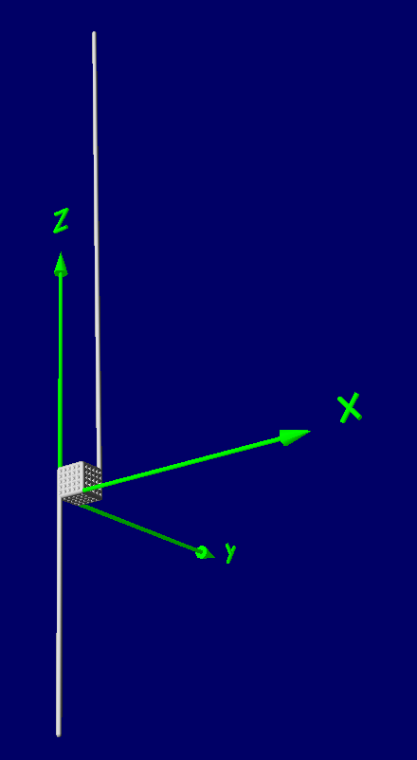
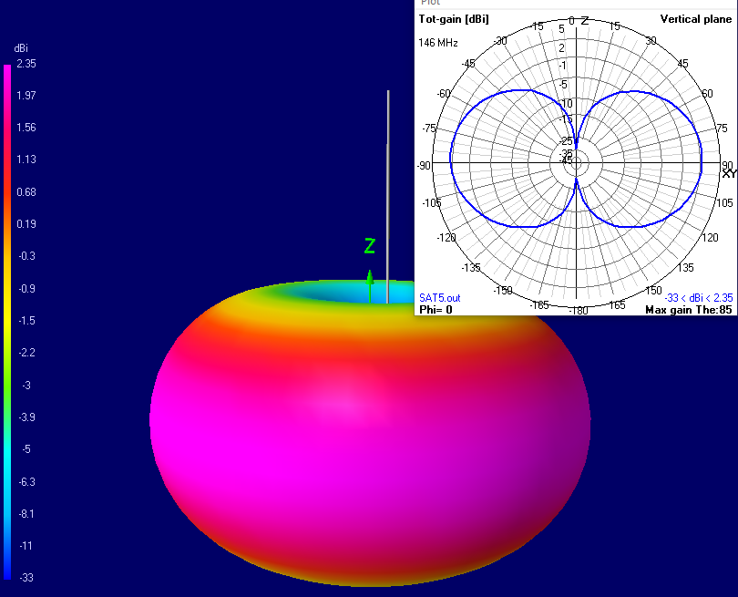
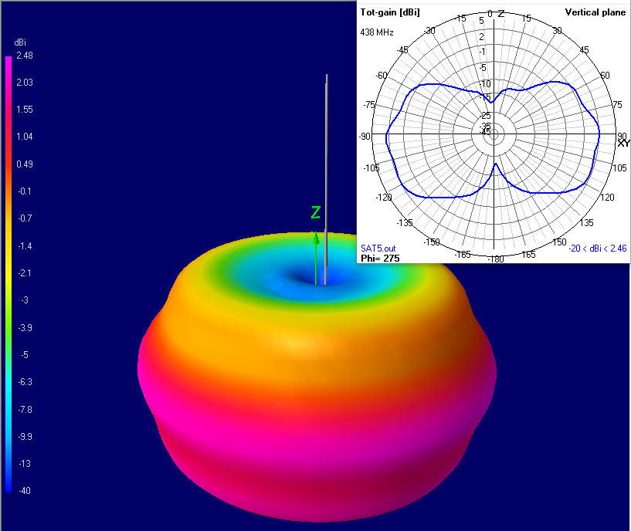
Monopole Antennas
Notes:
To be able to use the satellite as a relay of radio amateur frequencies it was decided to use monopole wavelength antennas, which measure 1.03m (half wavelength) and 0.69m, 145.9MHz VHF uplink and 436MHz UHF downlink respectively (approximate measures, might change).
This would allow for radio amateurs to use low gain transmission and reception antennas, which in general, have lower cost, to use EASAT2-UESAT1 as a relay. One of the objectives is that anyone with a Walkie Talkie and a small antenna should be able to use it.

Slide 28
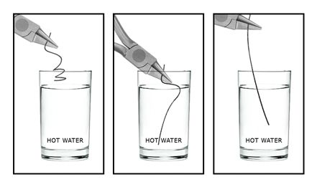
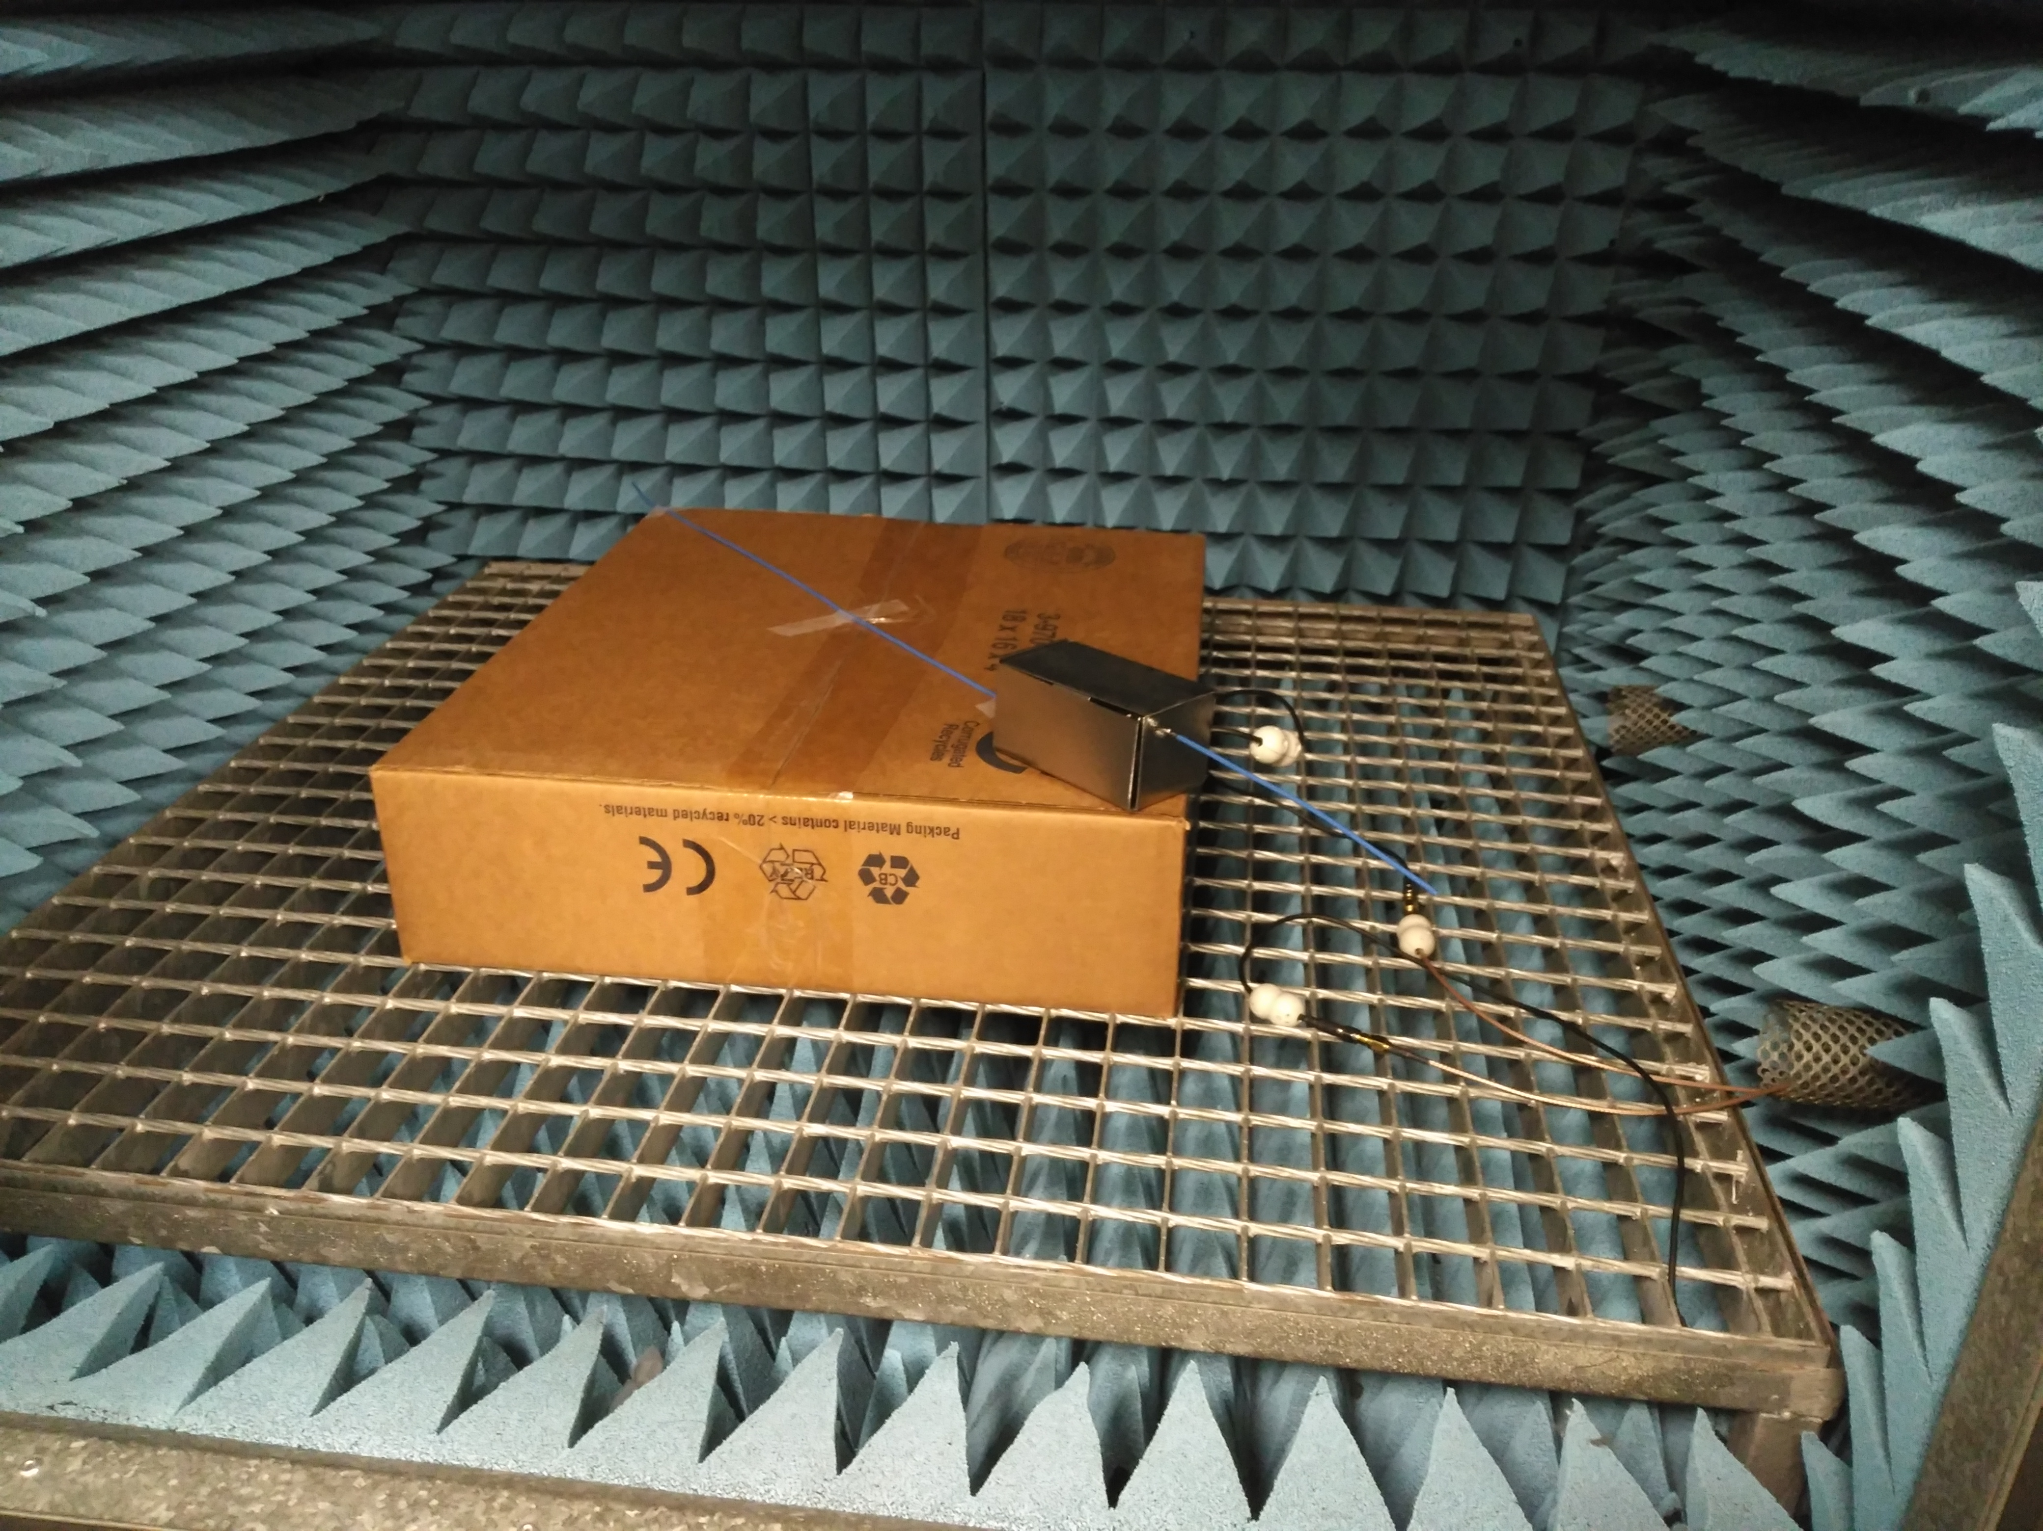
Unfolding Mechanism of the Antennas
  Shape-Memory Alloys –> Nitinol

Slide 29
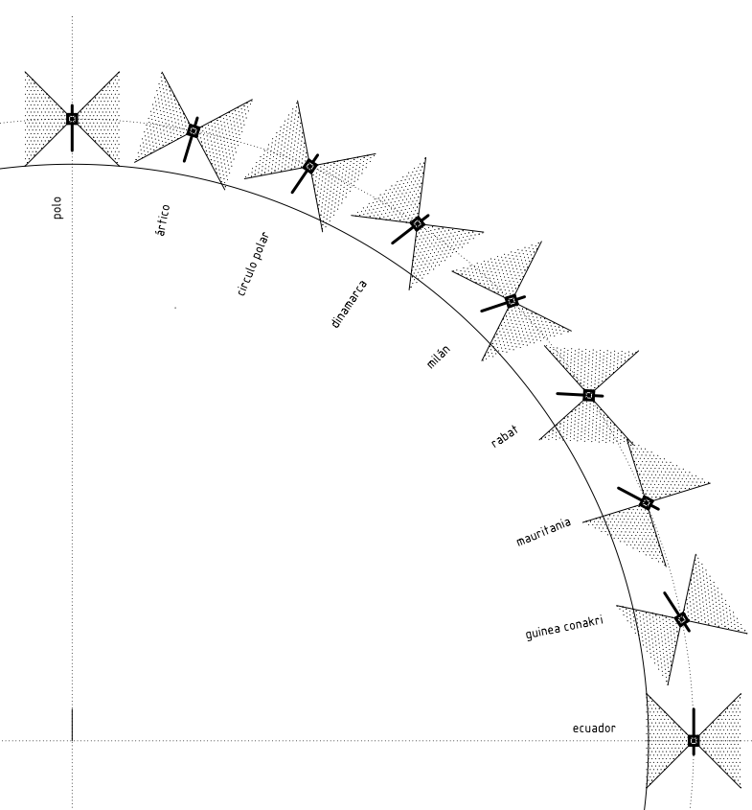
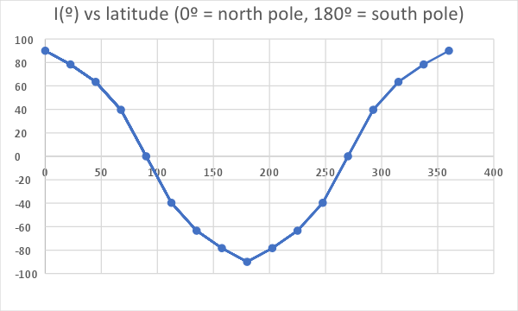

ACS – Passive Magnetic Attitude Stabilization System
Non-controlled rotation
$$\overset{→}{B}$$
Permanent magnet
Hysteresis rods

Slide 30
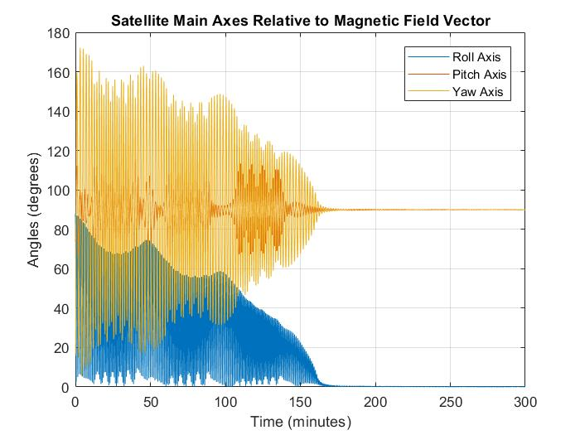
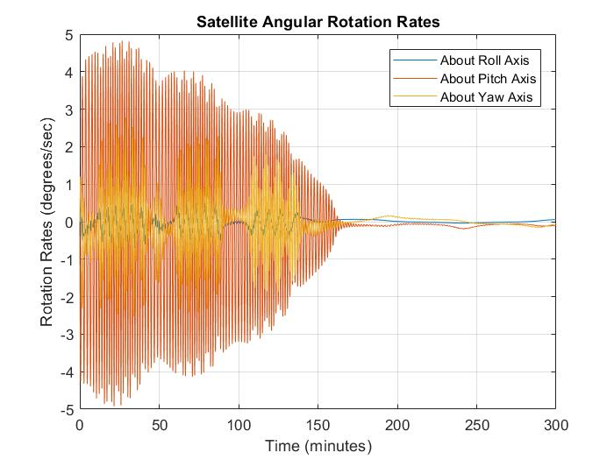
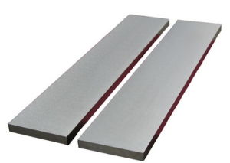
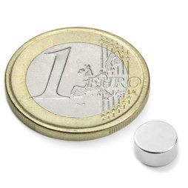
ACS – Passive Magnetic Attitude Control

Slide 31
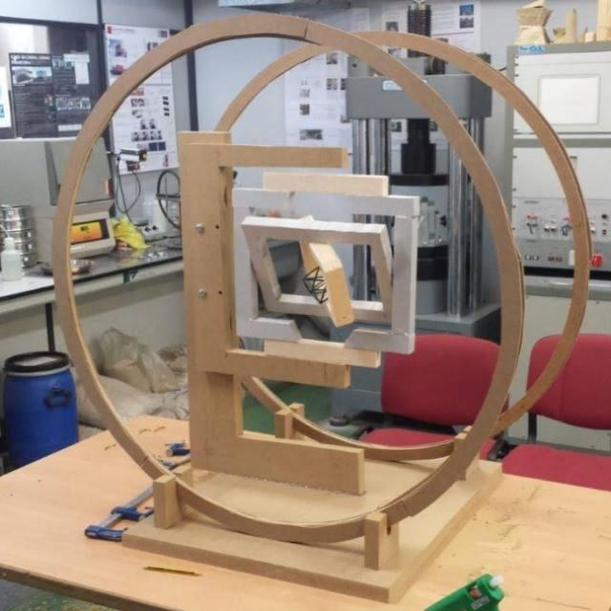
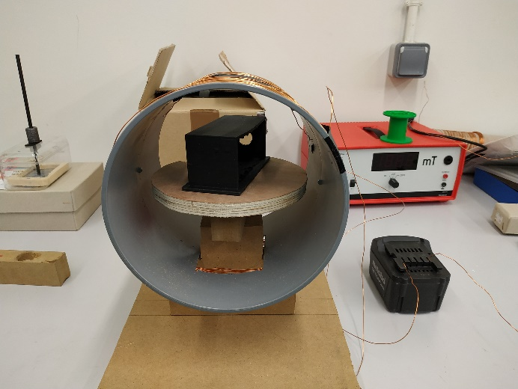
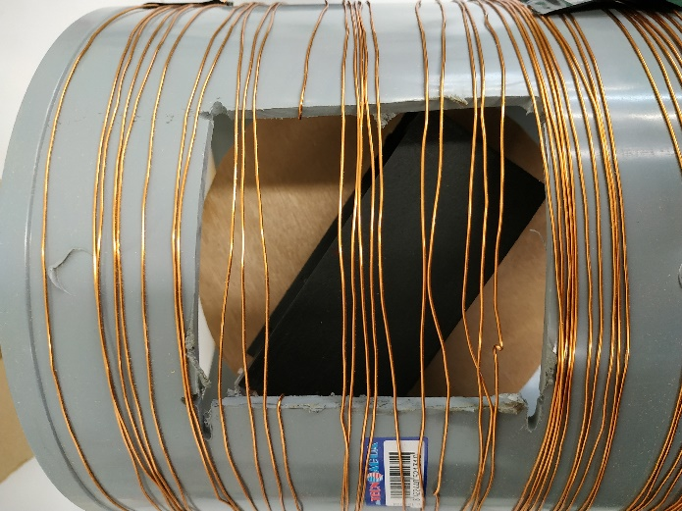
ACS – Passive Magnetic Attitude Control

Slide 32
On-board Processor
8 bit / 4MHz COTS microcontroller (microchip 18F45K22 (same as 50$SAT))

Slide 33
On-board Processor
8 bit / 4MHz COTS microcontroller (microchip 18F45K22 (same as 50$SAT))
Sends telemetries: temperatures, voltages, internal counters, etc.

Slide 34
On-board Processor
8 bit / 4MHz COTS microcontroller (microchip 18F45K22 (same as 50$SAT))
Sends telemetries: temperatures, voltages, internal counters, etc.
Receives telecommands: remote switch-off, squelch level,...

Slide 35
On-board Processor
8 bit / 4MHz COTS microcontroller (microchip 18F45K22 (same as 50$SAT))
Sends telemetries: temperatures, voltages, internal counters, etc.
Receives telecommands: remote switch-off, squelch level,...
Lithium battery monitoring and charging control
  Safe voltage/temperature ranges, charge accounting

Slide 36
On-board Processor
8 bit / 4MHz COTS microcontroller (microchip 18F45K22 (same as 50$SAT))
Sends telemetries: temperatures, voltages, internal counters, etc.
Receives telecommands: remote switch-off, squelch level,...
Lithium battery monitoring and charging control
  Safe voltage/temperature ranges, charge accounting
Baseband digital signal processing (200samples/s)
  ASK decoder, packet disassembly, CRC, FEC
  ASK encoder
  ALC automatic level control (constant output power)

Slide 37
On-board Processor
8 bit / 4MHz COTS microcontroller (microchip 18F45K22 (same as 50$SAT))
Sends telemetries: temperatures, voltages, internal counters, etc.
Receives telecommands: remote switch-off, squelch level,...
Lithium battery monitoring and charging control
  Safe voltage/temperature ranges, charge accounting
Baseband digital signal processing (200samples/s)
  ASK decoder, packet disassembly, CRC, FEC
  ASK encoder
  ALC automatic level control (constant output power)
Squelch activation
  (if nobody uses the transponder, we send solar power to bat)

Slide 38
On-board Processor
EASAT2
analog-digital
signal chain

Slide 39
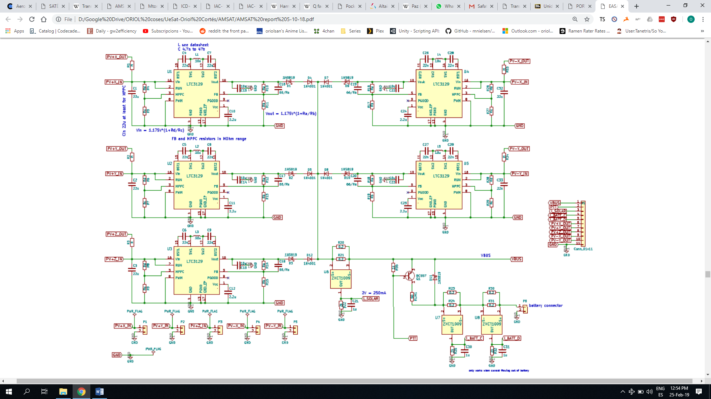
EPS – Circuit Board

Slide 40
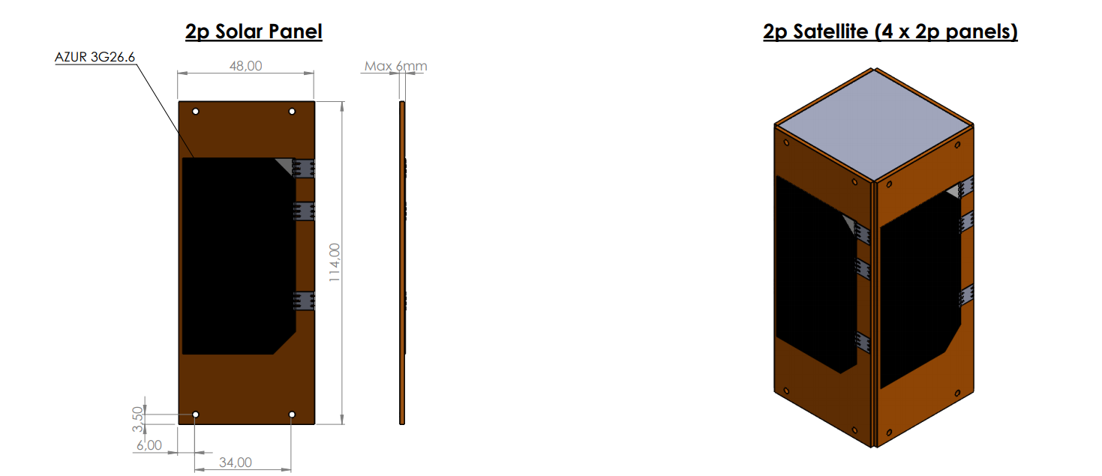
EPS – Solar Panels
4 x AZUR 3G26.6 ~10k€
Generate ~1W each

Slide 41
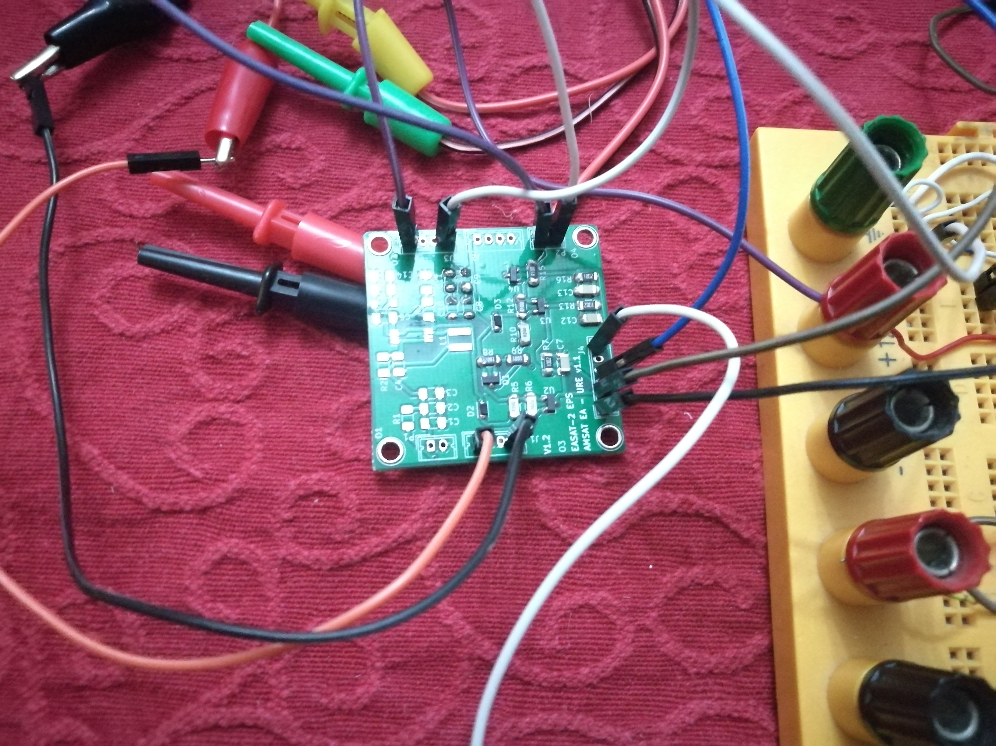
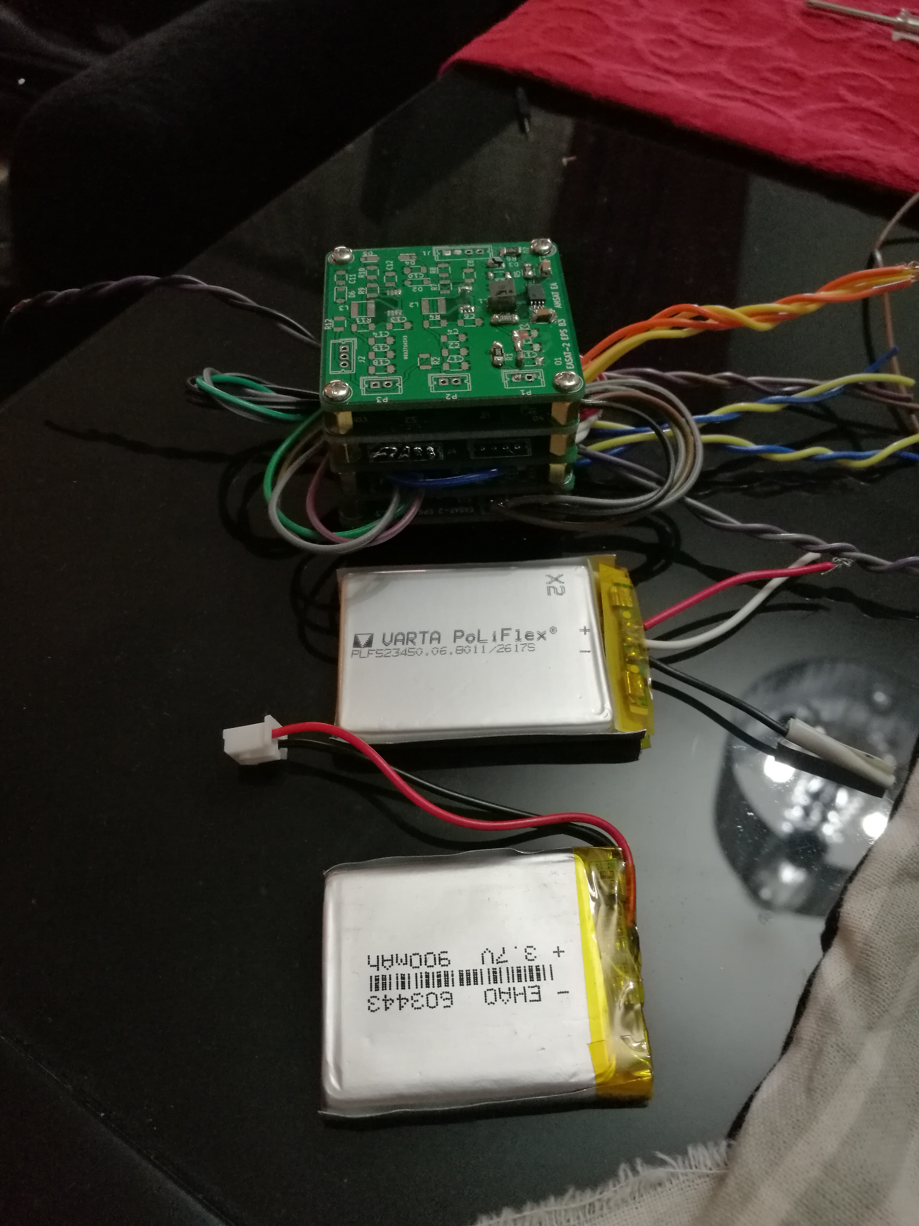
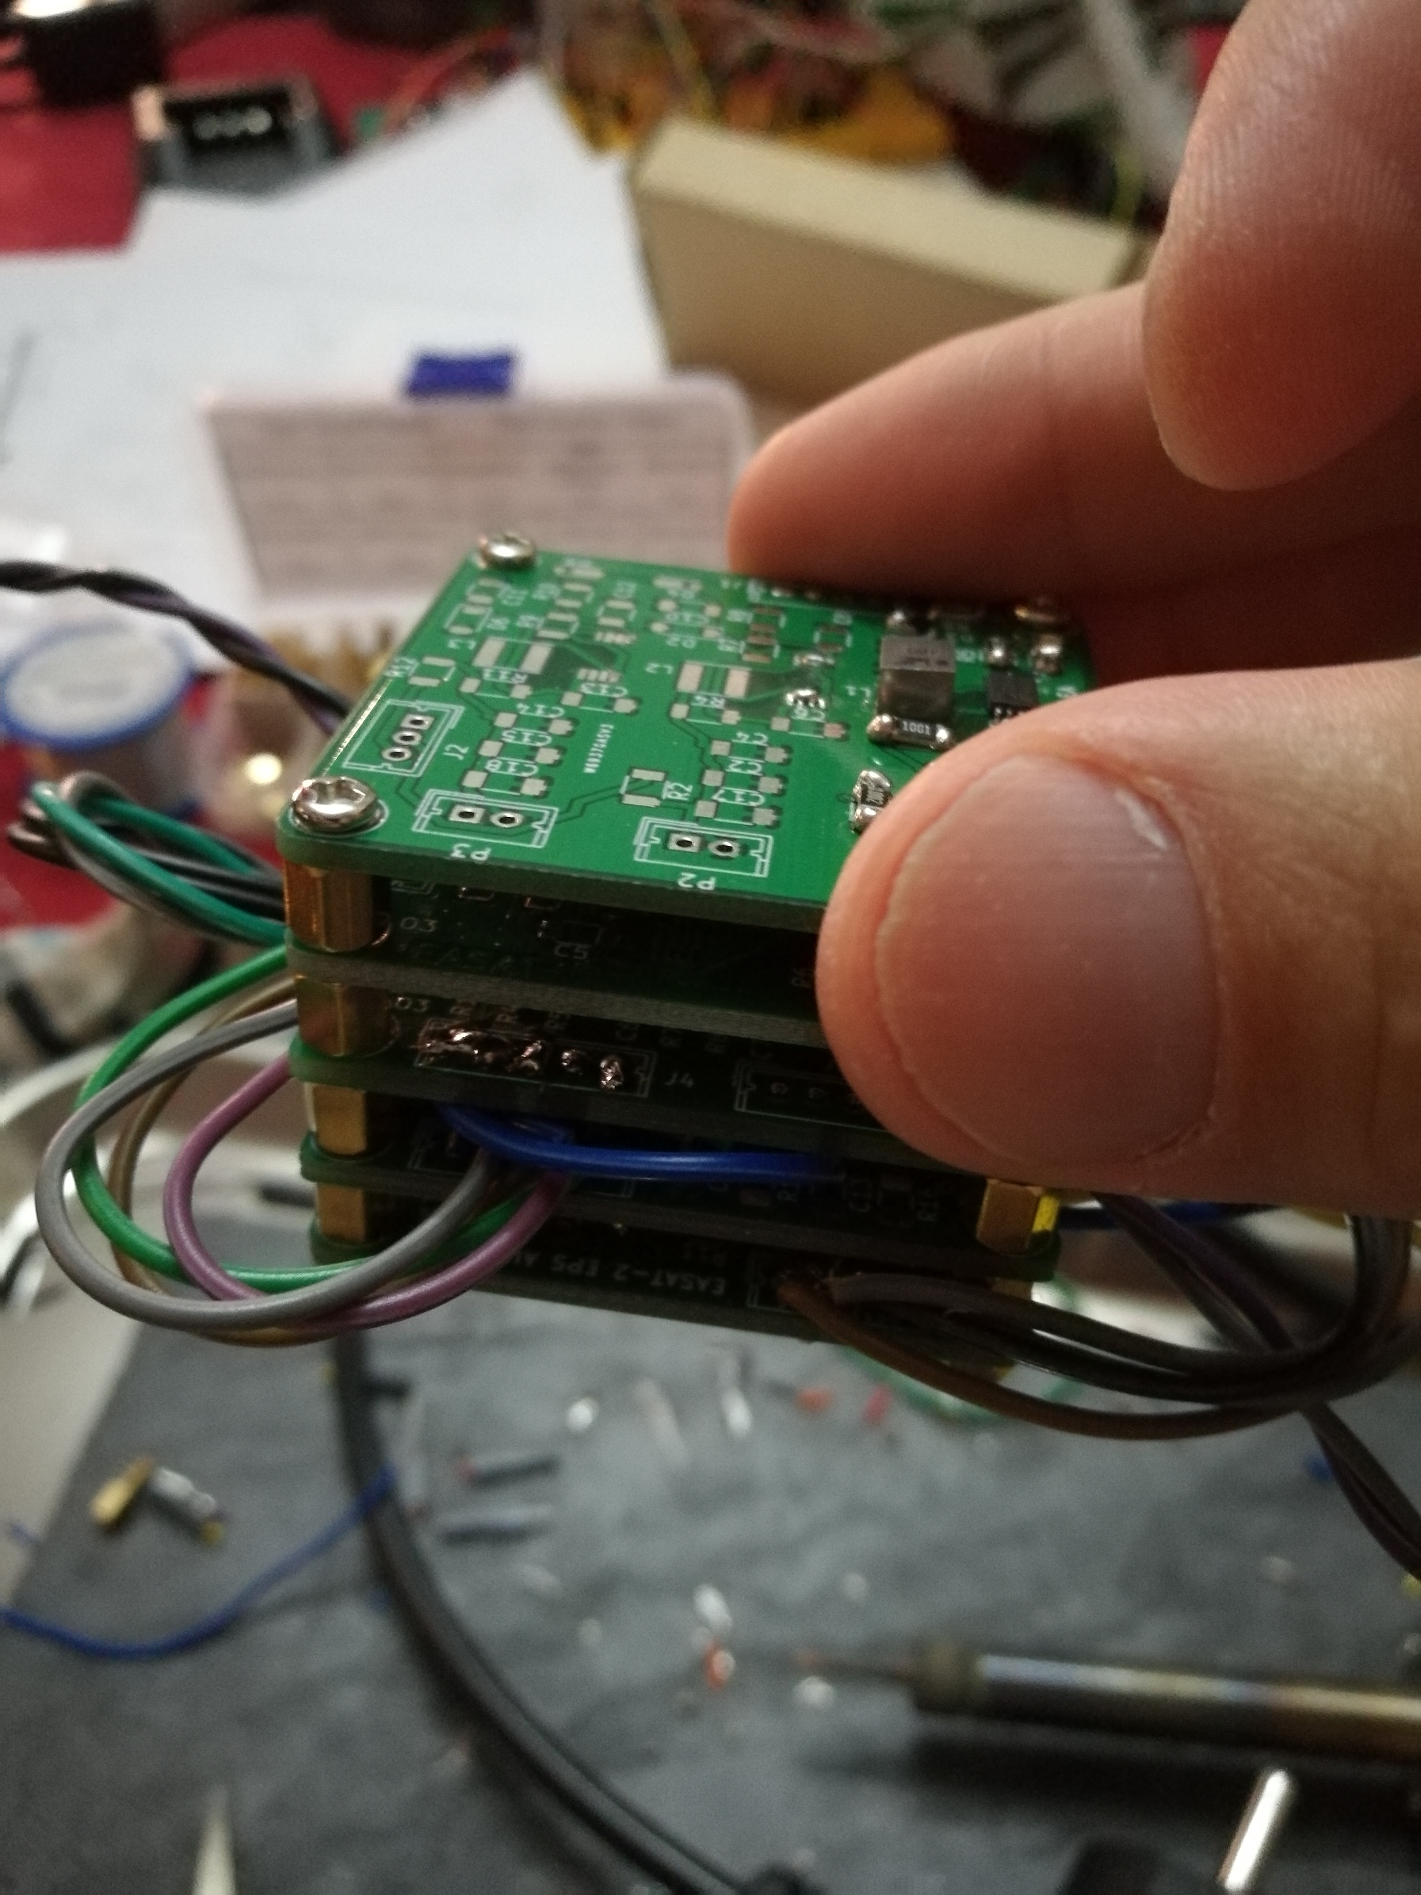
EPS – Testing

Slide 42
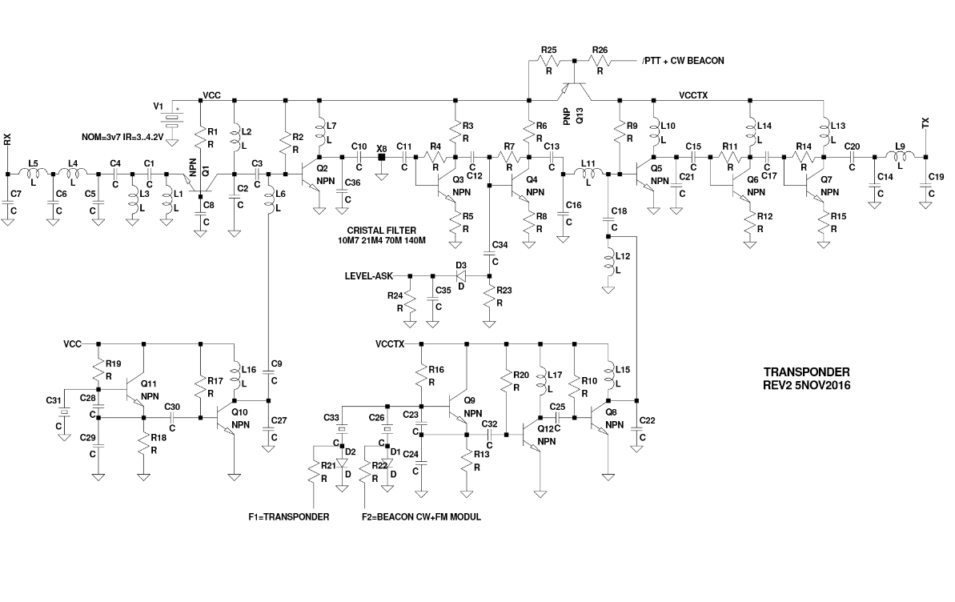
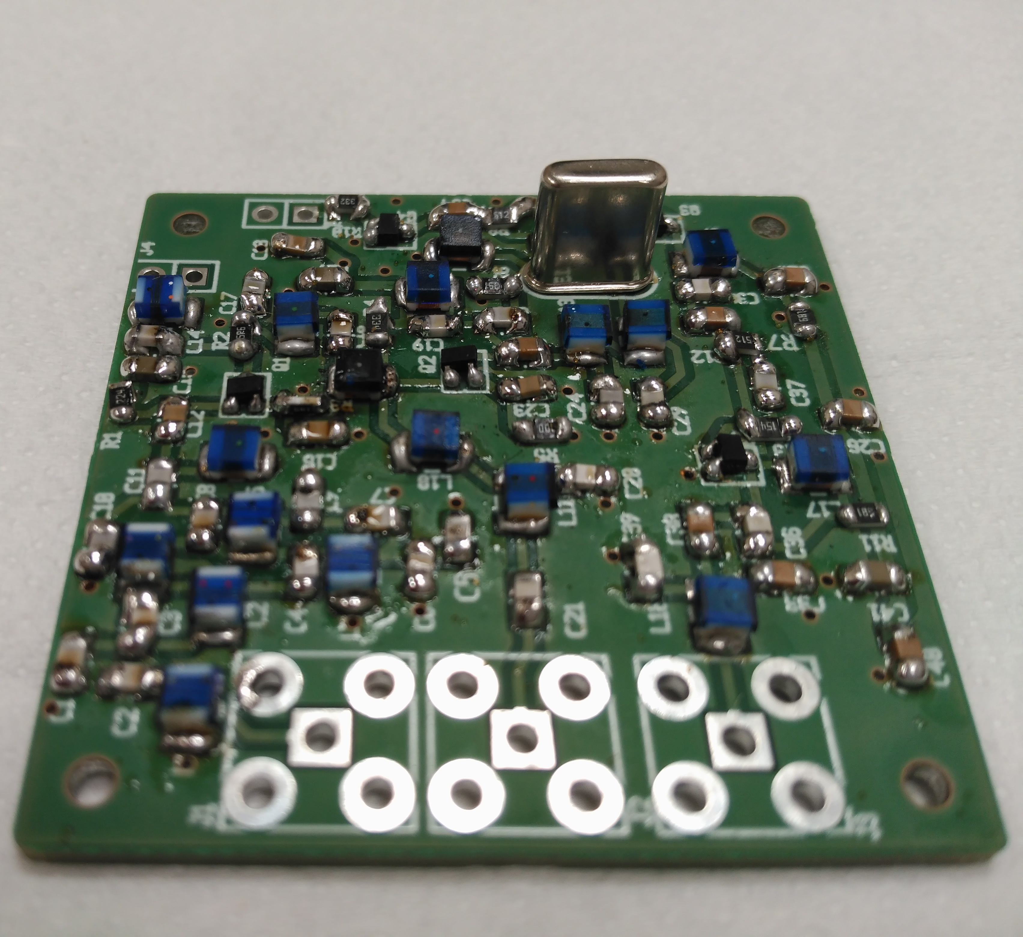
Linear Transponder VHF → UHF Circuit
Notes:
The reception and emission subsystem of EASAT2-UESAT1 is based on a linear transponder VHF -> UHF, made out of discrete components (transistors, condensers, etc.) without any integrated board. It is required of the subsystem to be very resistant to failures due to radiation to increase the useful lifespan of the satellite. Its reception band is VHF and transmission band is UHF. It can work with any communication in FM, SSB or any digital modes of low energy. The linear transponder will copy any transmission that is registered above the general noise in a certain dynamic threshold in the VHF band to the UHF band and transmitted back to ground.

Slide 43
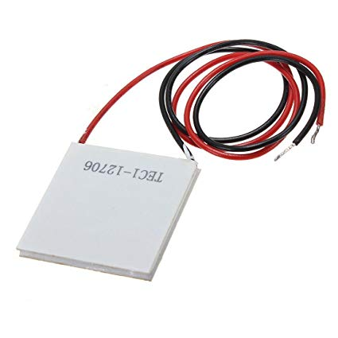
Stirling Engine
Difference in Temperature between the inside and the outside of the MLI to generate power & dissipate heat
Free Piston Stirling Engine
Design currently on hold
Peltier Module could be used instead
Notes:
The reception and emission subsystem of EASAT2-UESAT1 is based on a linear transponder VHF -> UHF, made out of discrete components (transistors, condensers, etc.) without any integrated board. It is required of the subsystem to be very resistant to failures due to radiation to increase the useful lifespan of the satellite. Its reception band is VHF and transmission band is UHF. It can work with any communication in FM, SSB or any digital modes of low energy. The linear transponder will copy any transmission that is registered above the general noise in a certain dynamic threshold in the VHF band to the UHF band and transmitted back to ground.

Slide 44
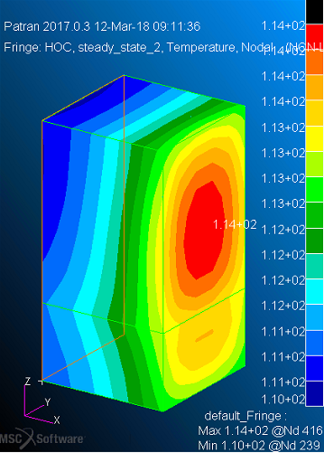
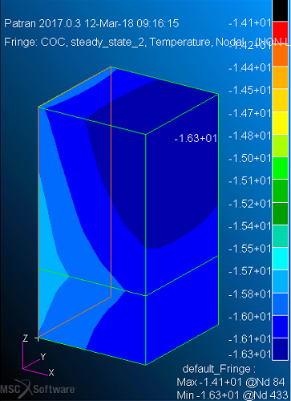
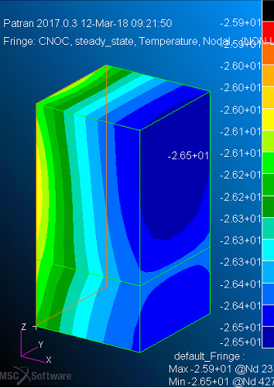
Thermal Design – Preliminary Simulation

Slide 45
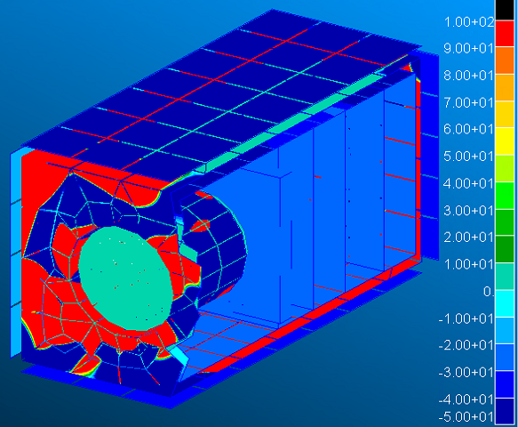
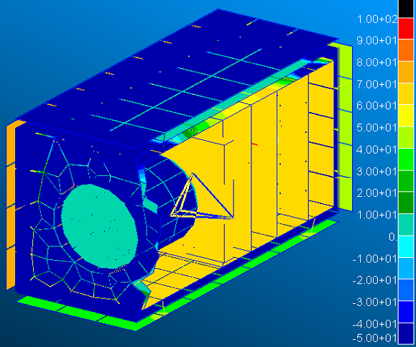
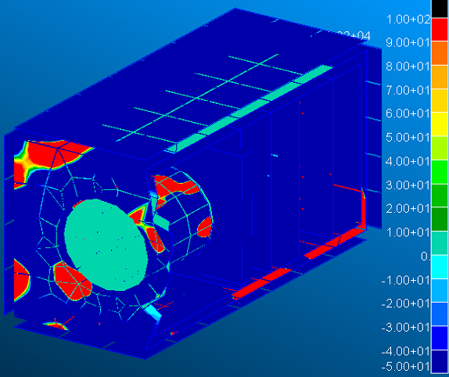
Thermal Design – Stirling Simulation

Slide 46
Thermal Design – Electronics Temp.

Slide 47
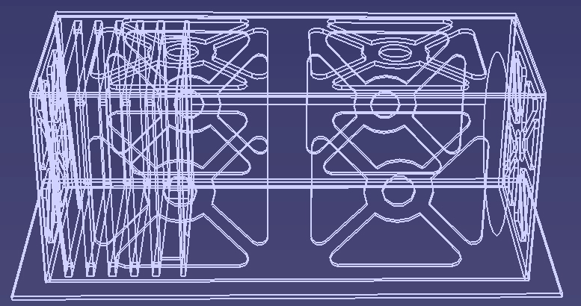
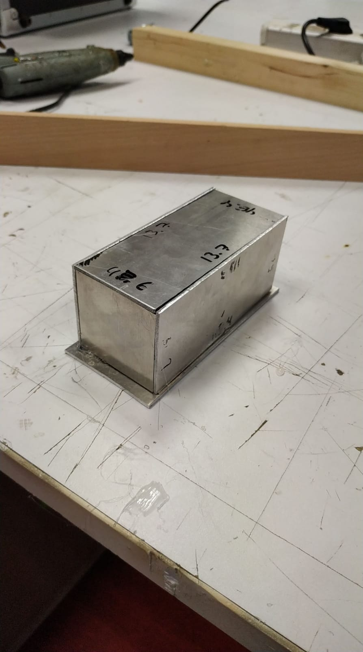
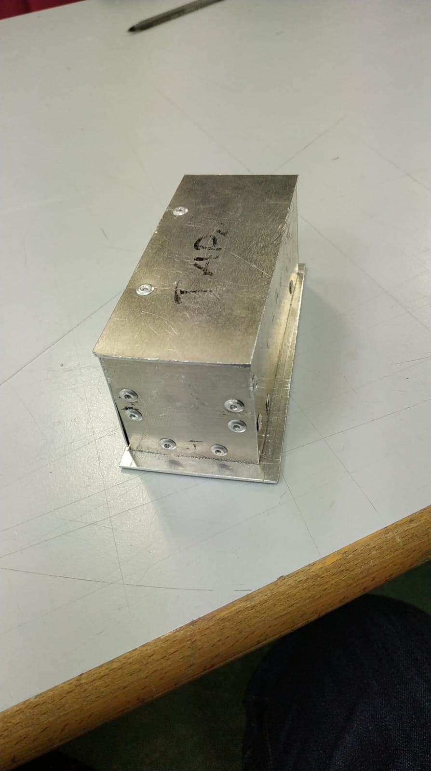
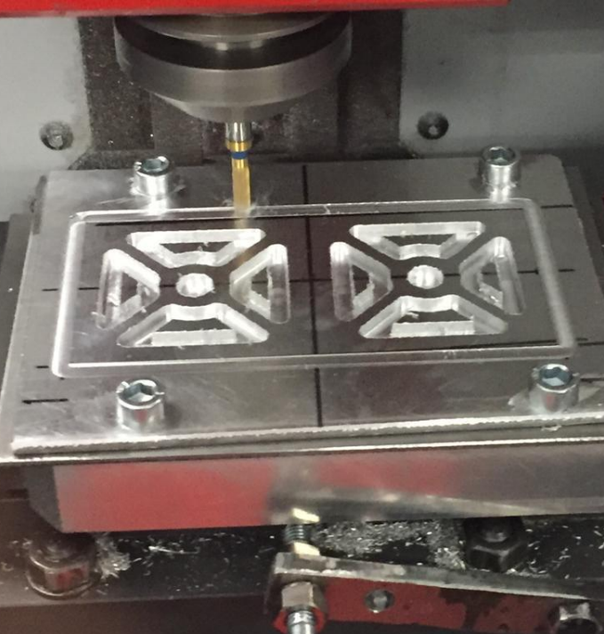
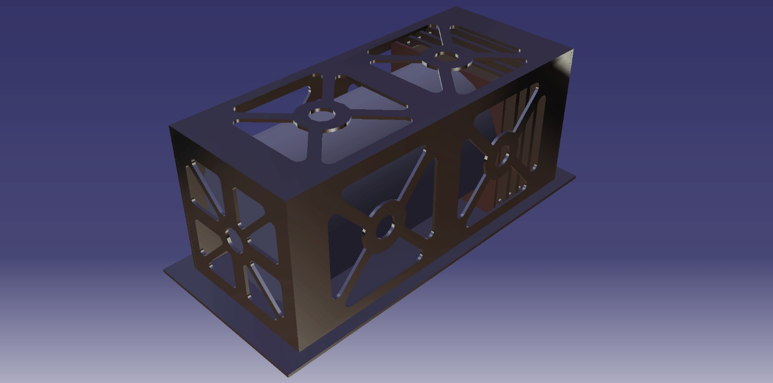
Mechanical Design – 1st Iteration

Slide 48
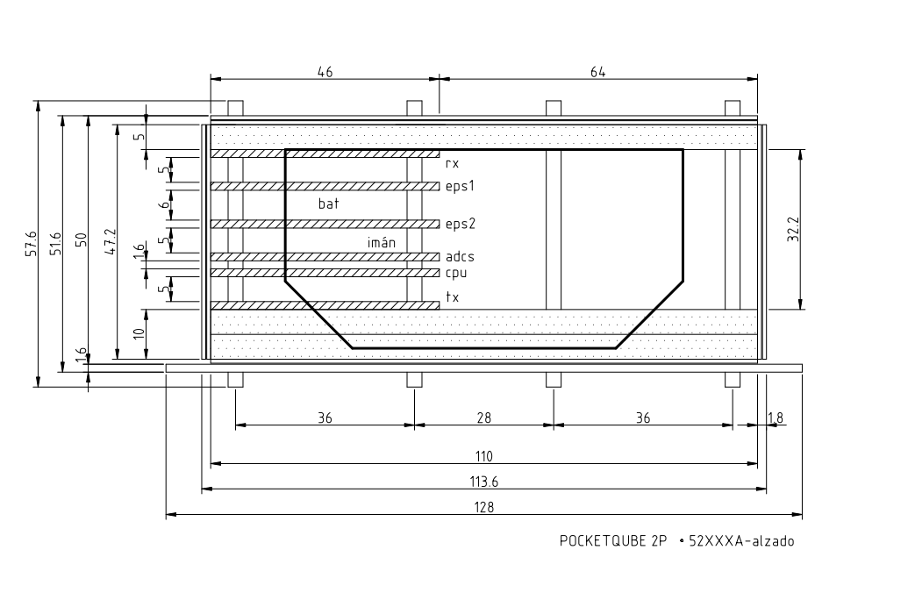
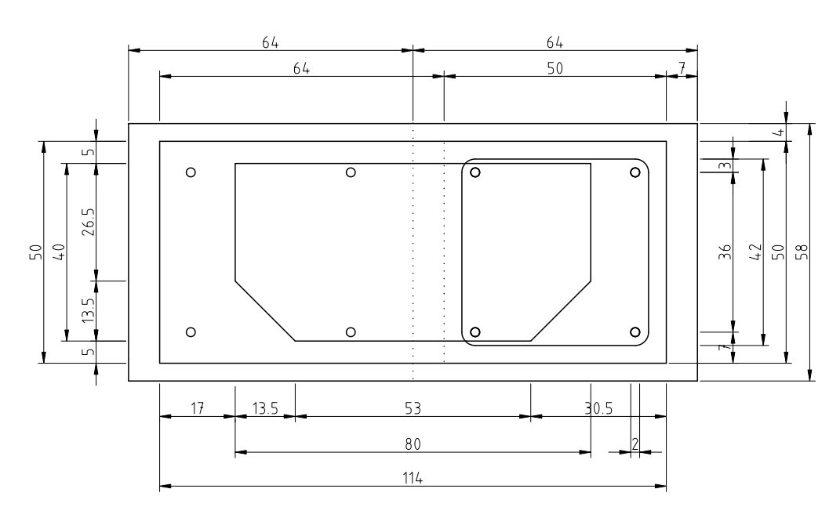
Mechanical Design – 2nd Iteration

Slide 49
PocketQube Workshop 2019
THANK YOU FOR YOUR ATTENTION
FEEL FREE TO ASK ANY QUESTIONS
oriolcortes1995@Gmail.com contacto@amsat-ea.org

