Slide 1
Development status of SatDuino
3rd PocketQube Workshop
Glasgow, Scotland
4-5 September, 2019
H. A. Cordero¹, J. M. Mercadin², L. Uriarte³, J. Pollio⁴, I. Mellina B. Petcoff⁵, L. Ricardo⁶, M. Magnani ⁷, M. Pascual ⁸, T. Martin⁹, S. Carrasco¹⁰, B. Lembo¹¹
^{1,2}Professors, EESTN° 5 school, Juan B Justo 4287, Mar del Plata CP 7600, Gral. Pueyrredon, Buenos Aires, Argentina; ⁴ Student, EESTN°5, Project Leader; ^{3,9} Students, EESTN°5, Software area; ^{5,10,11} Students, EESTN°5, Cloud area; ^{6,8} Students, EESTN°5, Marketing area; ⁷ Student, EESTN°5, Hardware area.

Slide 2
Contents
Introduction
System overview
OBC
COMMS
Power subsystem
Payload
GND Station
Software
Dashboard
Further works

Slide 3
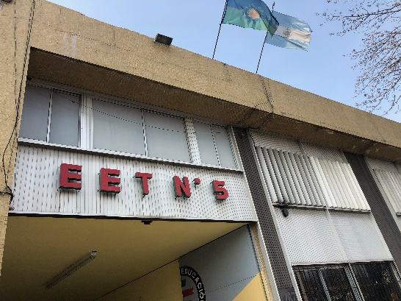
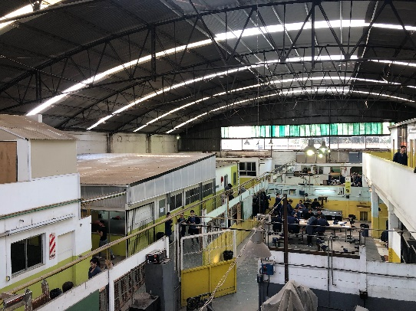
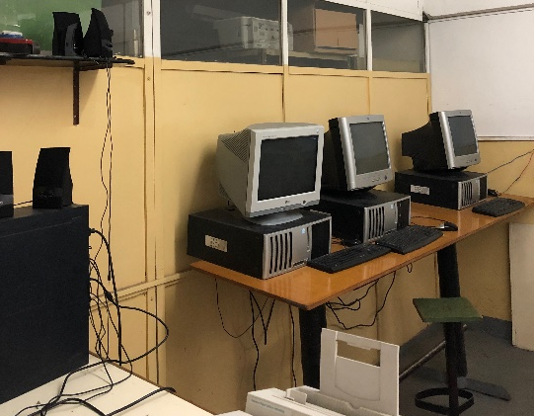
SatDuino
SatDuino is the first Argentine PocketQube. It is being developed by EEST Nº 5 technical school students in Mar del Plata, Argentina.
Objectives
Create the first Argentinian Pico satellite, totally built by technical schools students.
Develop it using low cost, high-impact technologies.
Introduce students to aerospace technologies.
Develop digital knowledge and promote computational thinking.
EEST Nº5 school, Mar del Plata, Argentina.

Slide 4
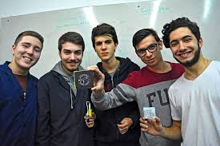
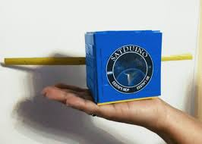
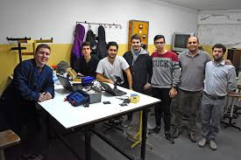
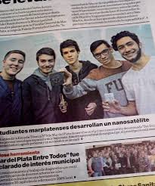
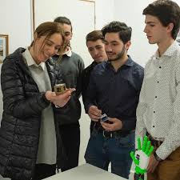
SatDuino
Media repercussions:

Slide 5
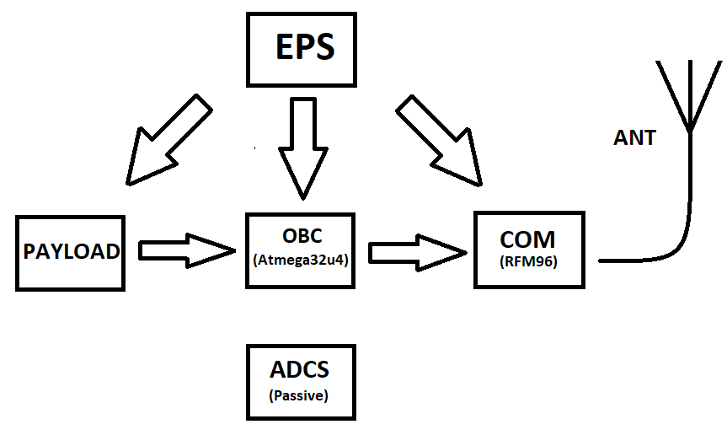
System overview
PocketQube block diagram.

Slide 6
On-Board Computer
The first prototype includes an Atmega 328P CPU.
The following prototypes are based on an Atmega 32U4 chip.
Watchdog: MAX6369.
Future improvements
STM32 family CPUs.
Current control.
Voltage control.
Antenna deployment control.

Slide 7
Communication subsystem
The communication is produced by a LoRa RFM95 platelet at a frequency of 433MHZ.
Antenna: measuring tape, connected by UFL connectors, SMD version.
Future improvements
SC1262 chip to replace RFM95.
TCXO cristal oscillator.

Slide 8
Power subsystem
One-cell lithium battery (180 mAh).
Solar battery load control (using TP4056 microcontroller)
AMS1117 3,3V MPPT.
Protection diode.
Future improvements
Replacement of the board prototype for a SPV1040 HESBC.

Slide 9
Payload
I2C communication protocol.
Built-in sensors:
Bosch BME680 (humidity, temperature, barometric pressure, pollution and altitude)
TDK InvenSense MPU9250 (9 axes gyroscope, accelerometer and magnetometer).
Future improvements
IoT communications system.
Camera addition.

Slide 10
Ground station
Communication: LoRa SX1278 chip.
CPU: ESP32.
WiFi connection.
Includes a 0,96 inch OLED screen.
Transmition at a 433MHZ frequency.

Slide 11
Software
Range tests were performed testing the following libraries:
LoRaNow
RadioHead
Heltec
From the results obtained it was concluded that RadioHead was the most suitable library due to its simplicity, organization and greater compatibility.

Slide 12
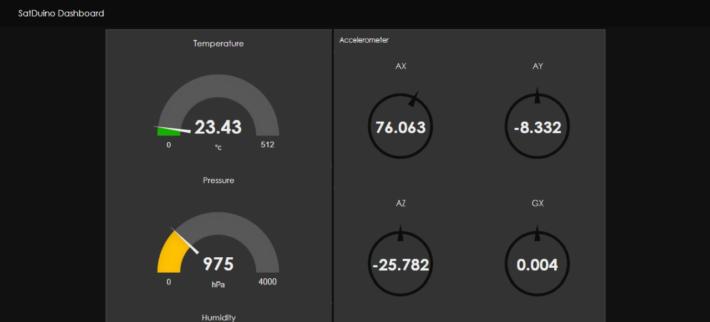
Dashboard
MQTT server: IBM Cloud.
Created on Node-Red IBM Cloud application (flow-based).
Displays payload data (sensor readings) and communication status (signal quality, working time).
Future improvements
Machine Learning implementation.
AI implementation.
Dashboard interface improvement.

Slide 13
Further works
Next project stages:
NOVEMBER.
Range tests (stratosphere)
Range test 1 : communication.
Range test 2: communication and payload variables.
NEXT YEAR.
OBC upgrade (to 32 bits).
Payload upgrade (camera addition).
Pasive navigation system addition.
First and only project in South America of collaborative PocketQube Mexico-Argentina.

Slide 14
THANK YOU

