Slide 1
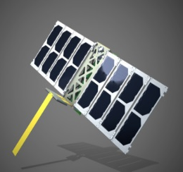
UNICORN-2 SATELLITE
Dr. C. Constantinides (MM6XOM)

Slide 2
OVERVIEW
Miniature Satellites & Alba Orbital
  The goal
  Scaling down & flying
  The satellites: Unicorn-1 & 2
Configuration of the Unicorn-2 satellite
  Overview
  Guidance system
  Ground station
Applications & potential collaborations
R&D / Commercial / Ham Radio Challenges
05/09/2019
1

Slide 3
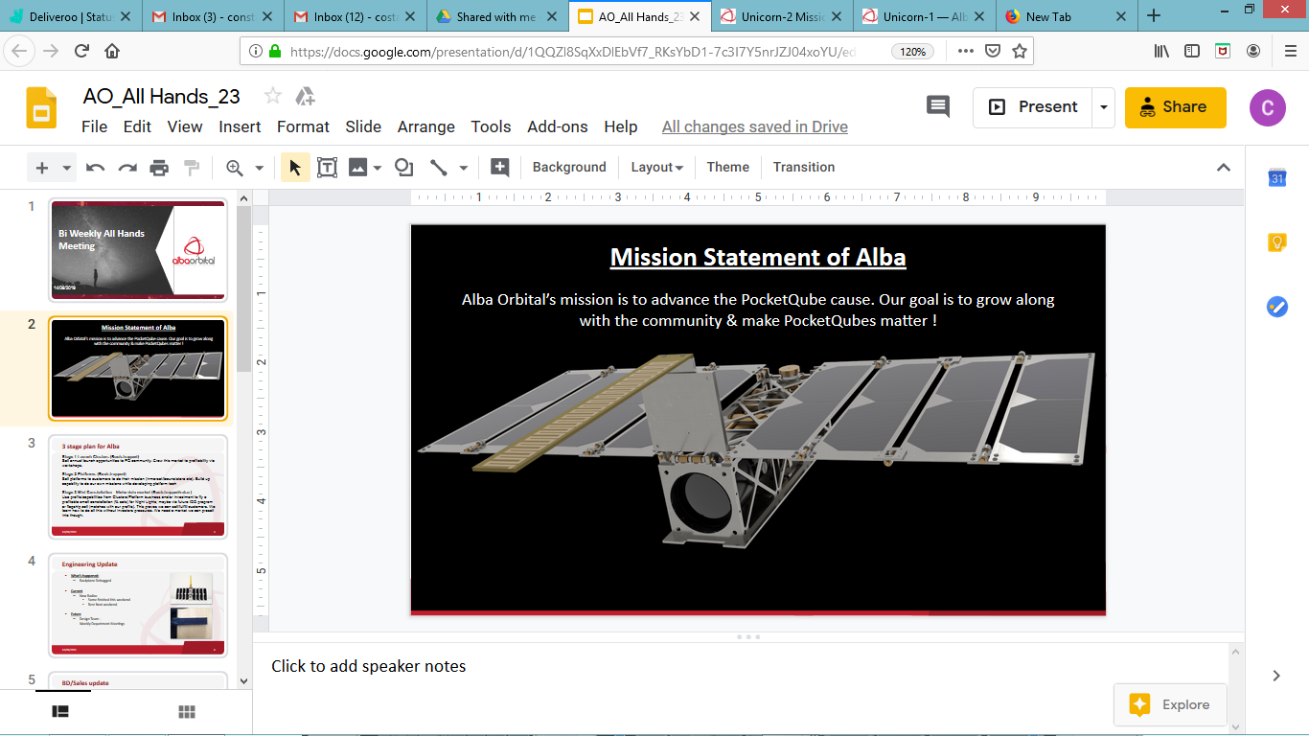
05/09/2019
1

Slide 4
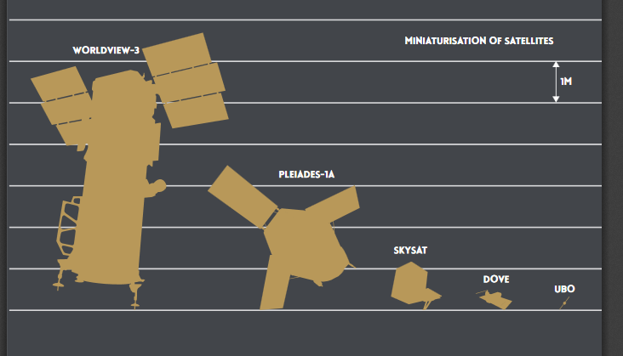
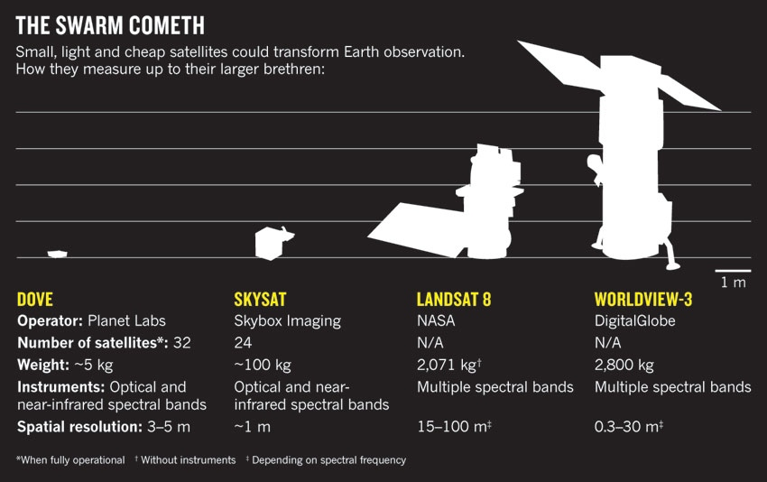
The shrinking is well justified
  Compact ⬄ Less expensive & Less Junk in Space
Possibility of having bigger satellite constellations
  Easier tracking
05/09/2019
1

Slide 5
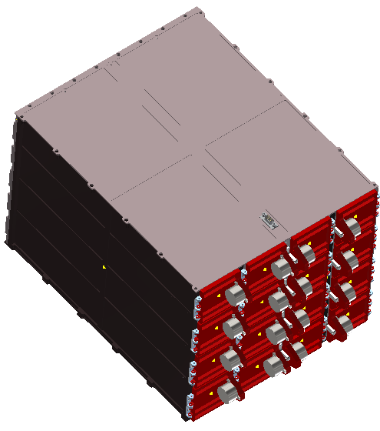
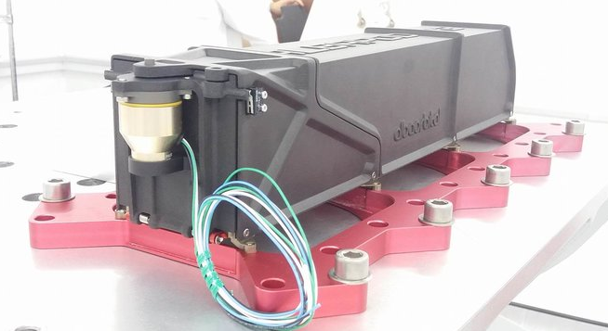
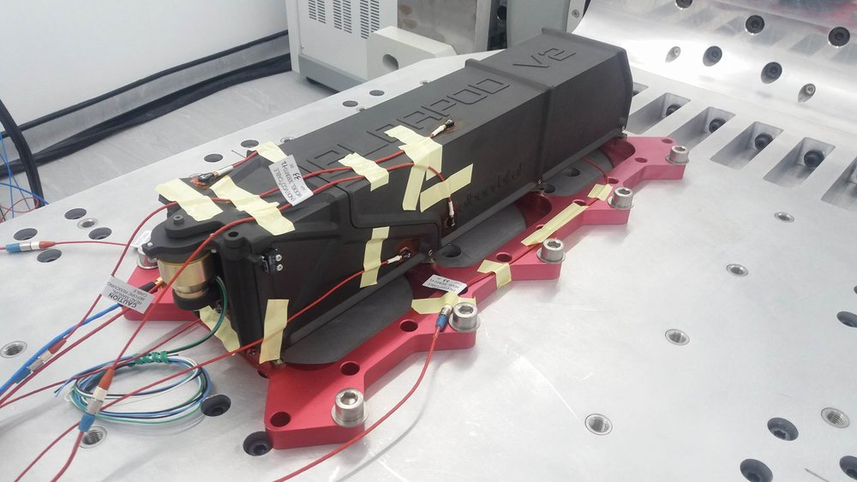
Make it fly !!
6p POD
96p POD
05/09/2019
1

Slide 6

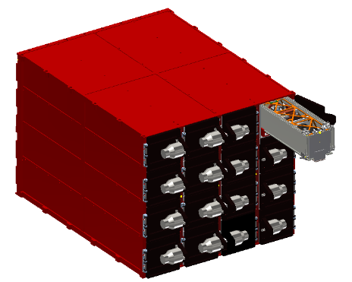
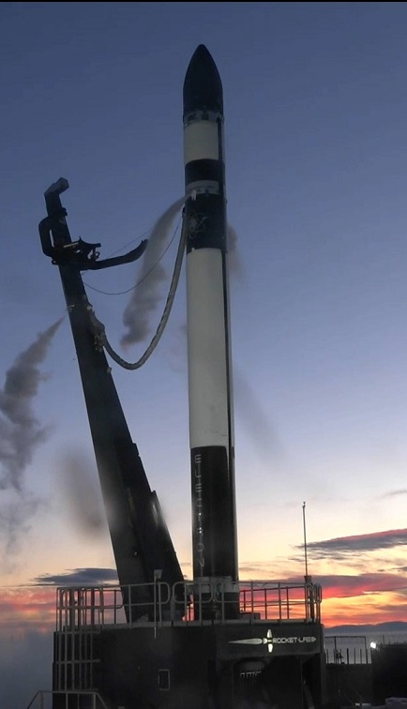
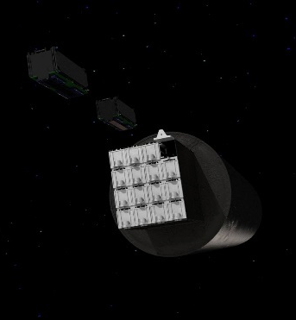
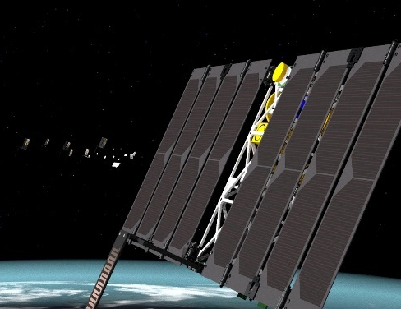
Alba Orbital & PocketQubes
Working up from parts to full platforms
10 FT Staff and growing
Currently planning for production rate of 1/month with new facilities (2020-2021)
When in space
96p pod
https://www.rocketlabusa.com/gallery/
05/09/2019
1

Slide 7
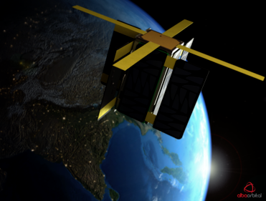
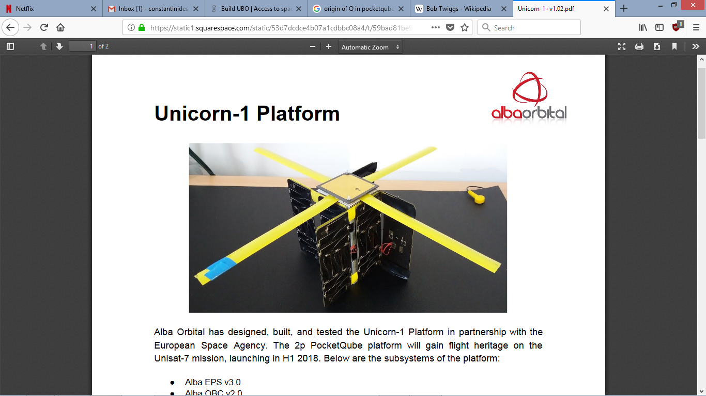
FROM UNICORN – 1 ...
Size: 2p (Double PocketQube), 50mm x 50 mm x114mm
Payload Volume: 1P (50mm x 50mm x 50mm)
Mass: 490 grams (approx). 100g available for payload
Payload: S-band Inter Satellite Link (ISL) radio,
Orbit: SSO
Power: 1W On-Orbit Average Power
Passive attitude stabilisation
PQ60 Payload Compatible - see www.pq60.net
05/09/2019
1

Slide 8
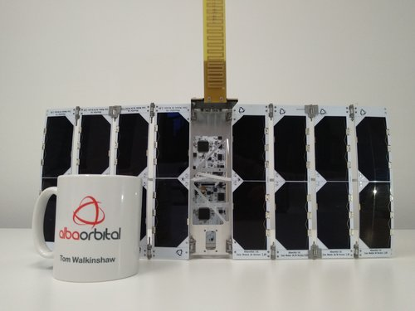
...TO UNICORN - 2

Slide 9
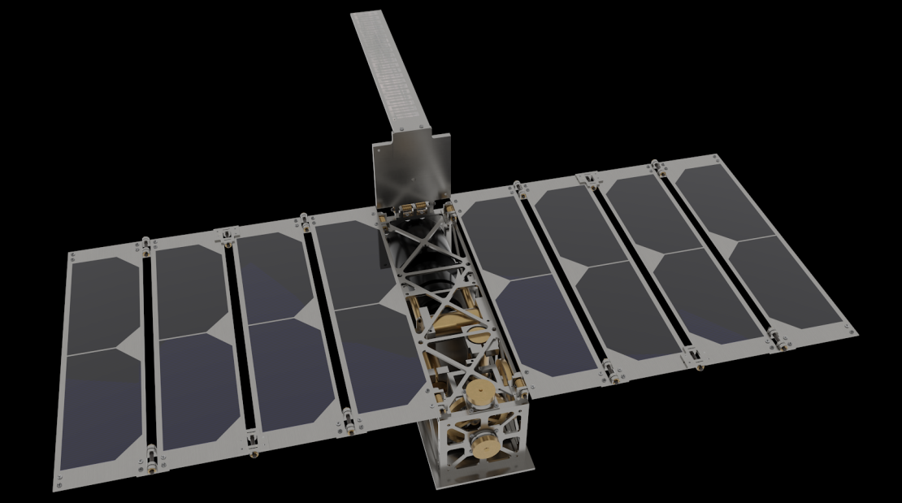
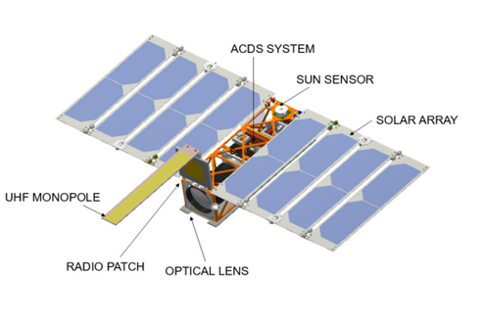
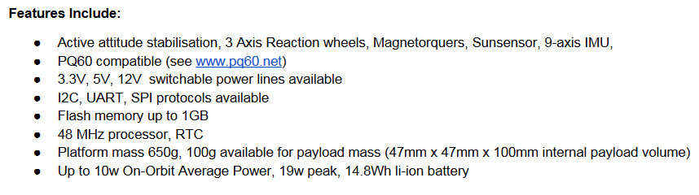
UNICORN - 2
z
x
y
X = 50 mm Y = 50 mm Z = 192 mm
750 gr.
05/09/2019
1

Slide 10
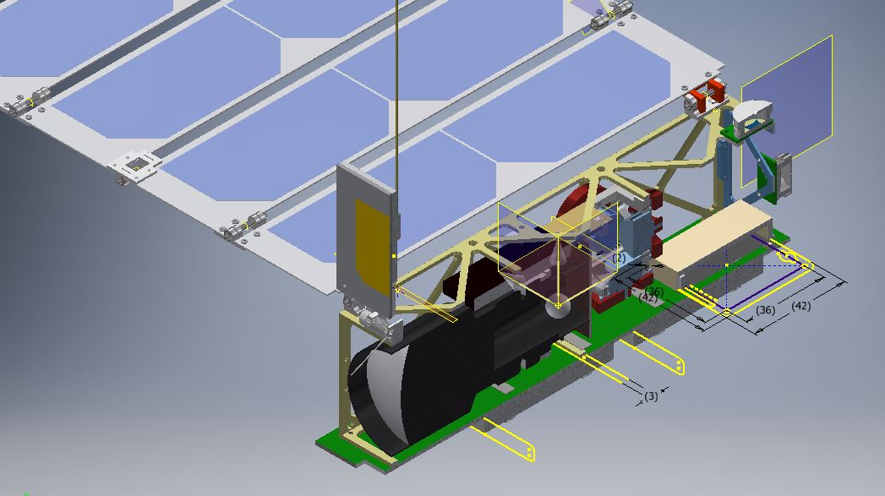
Configuration of the satellite
Sun
Sensors
UHF ANT
Solar
Panels
Magnetorquers &
Reaction Wheels
S-band ANT
UHF radio
Aluminum
Body
Batteries
Base
Plate
05/09/2019
1

Slide 11
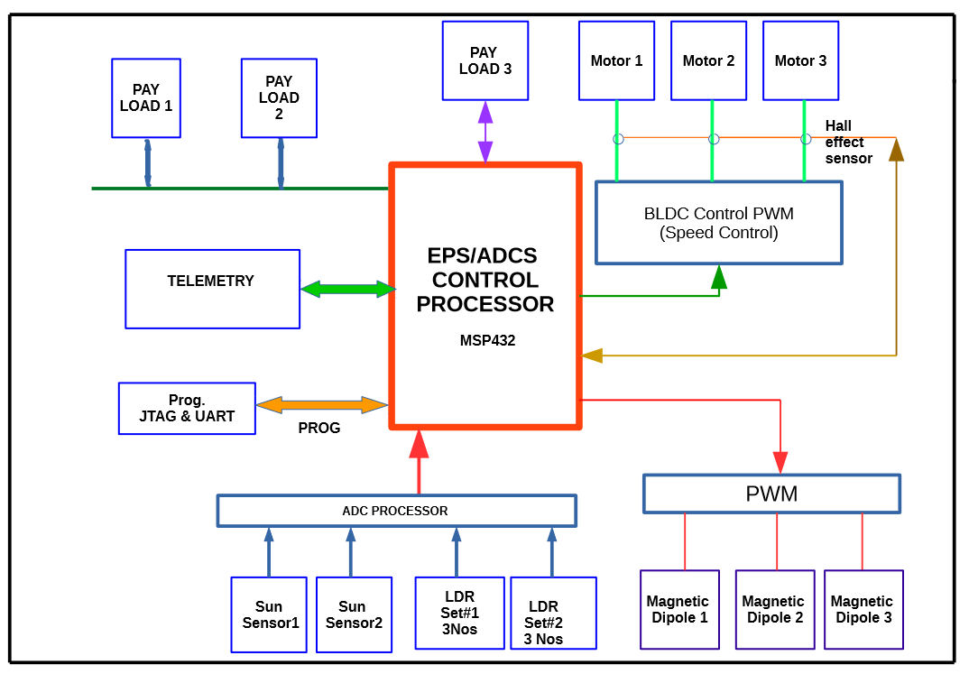
Configuration of the Unicorn-2 satellite
05/09/2019
1

Slide 12
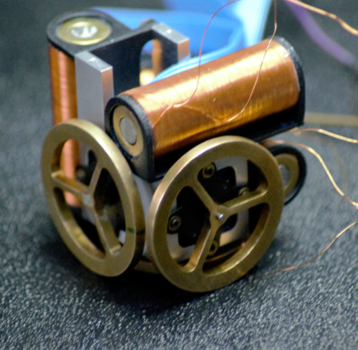
Pointing System
Pointing accuracy of 5 degrees.
Two 2 axis sun sensors
4 Light Dependent Resistors,
3 brushless motors with reaction wheels
3 axis magnetometer & magnetorquers.
05/09/2019
1

Slide 13
Configuration of the communications system: Overview
F_uplink
SATELLITE
F_downlink
GROUND STATION
Uplink/downlink frequencies can be different or the same
05/09/2019
1

Slide 14
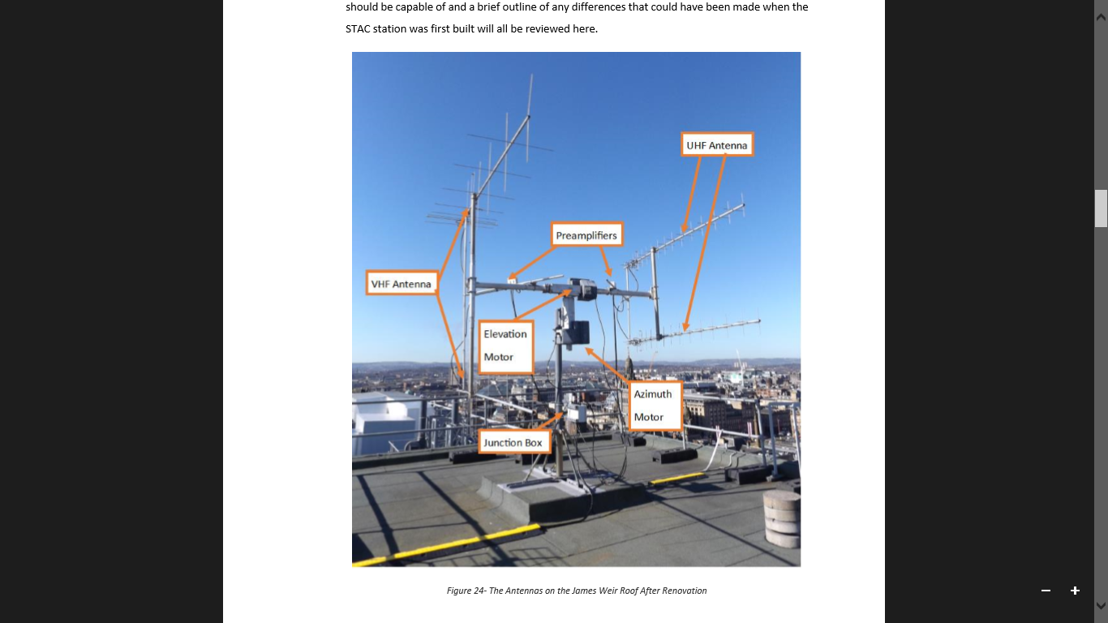
Configuration of the communications system: Overview
F_uplink
SATELLITE
F_downlink
GROUND STATION
Uplink/downlink frequencies can be different or the same
05/09/2019
1

Slide 15
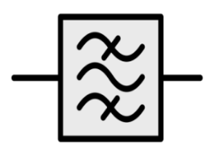
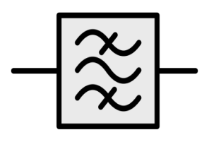
Configuration of the communications system: Ground Station
Tx
Rx
P A
LNA
SWITCH
Motors to rotate antenna in Azimuth & Elevation
Cables of high quality and minimum length as frequency increases
Upgrade to operate in S-band as well
05/09/2019
1
Notes:
<number>

Slide 16
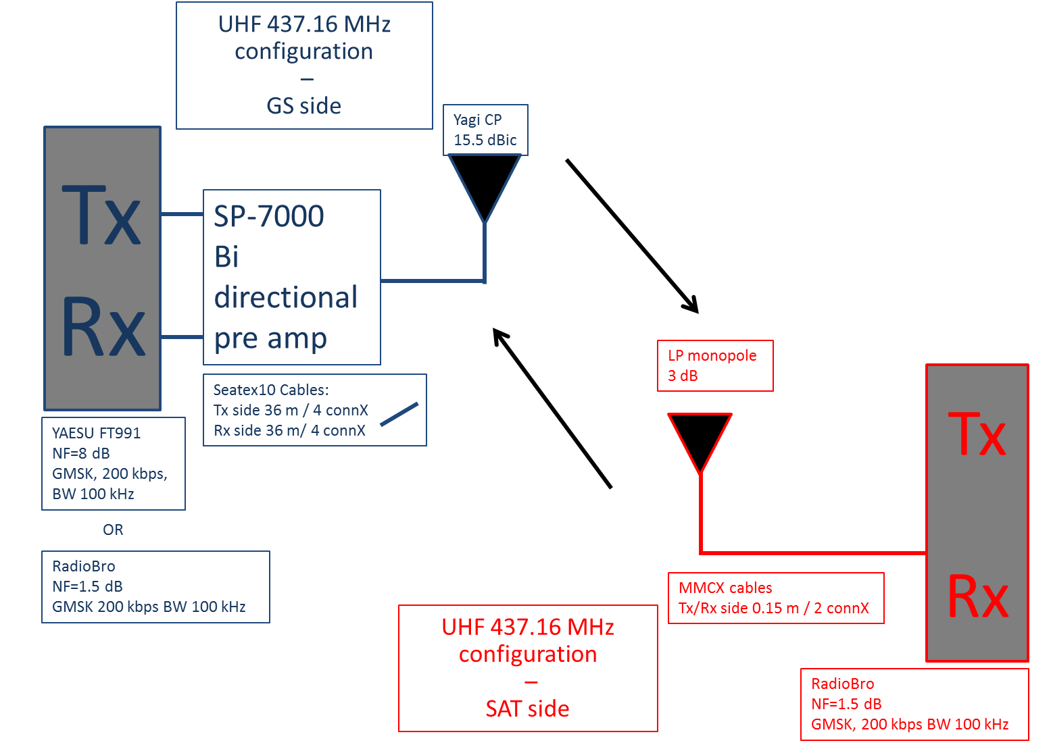
05/09/2019
1

Slide 17
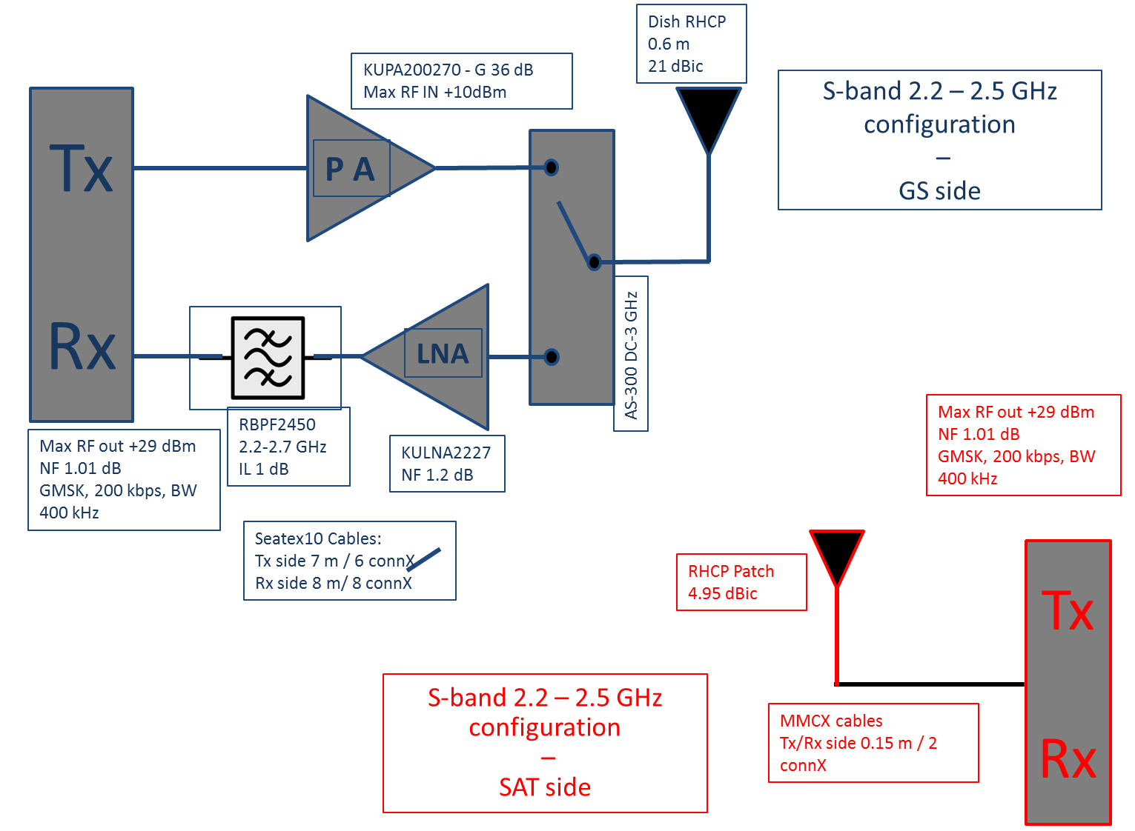
05/09/2019
1

Slide 18
Characteristics
Mission characteristics
  Mission orbit : LEO @ 385 km with 97º inclination.
  Amateur frequencies : 437.16 MHz & 2405 MHz.
  Orbital life < 45 days – Mission : technical demo with imaging
Link characteristics
  UHF LINK:
    UPLINK & DOWNLINK: ~0 dBW.
    GFSK modulation
    GS antenna: Circular Yagi with 14.15 dBic of gain with 30º HPBW
    Satellite Antenna : Monopole of ~ 3dBi
  S-band LINK:
    DOWNLINK
      Power ~ 0 dBW
      GMSK Modulation
    GS antenna : CP dish with 32 dBic of gain with 3º HPBW
    Satellite Antenna CP patch with 5 dBic of gain with 80º HPBW
  Custom made radios for the satellite (and the GS if necessary)
05/09/2019
1

Slide 19
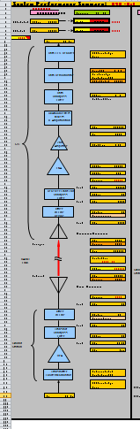
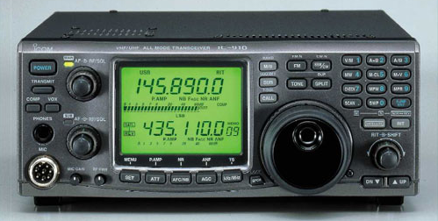
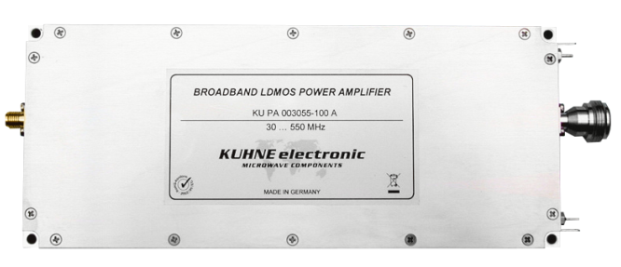
WHAT WE LEARNED
Optimize your system:
      Especially at higher frequencies (comms)
      MINIMIZE DEPLOYABLES
  PLAN YOUR TEST CAMPAIGN
        VIBE, BAKEOUT & TVAC
  THE LINK BUDGET
    http://www.amsatuk.me.uk/iaru/spreadsheet.htm
  CHOOSE EQUIPMENT WELL
    https://www.kuhne-electronic.de/
    http://www.icomuk.co.uk/IC-910H/Amateur_Radio_Ham_Base_Stations
05/09/2019
1

Slide 20
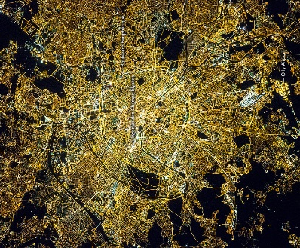
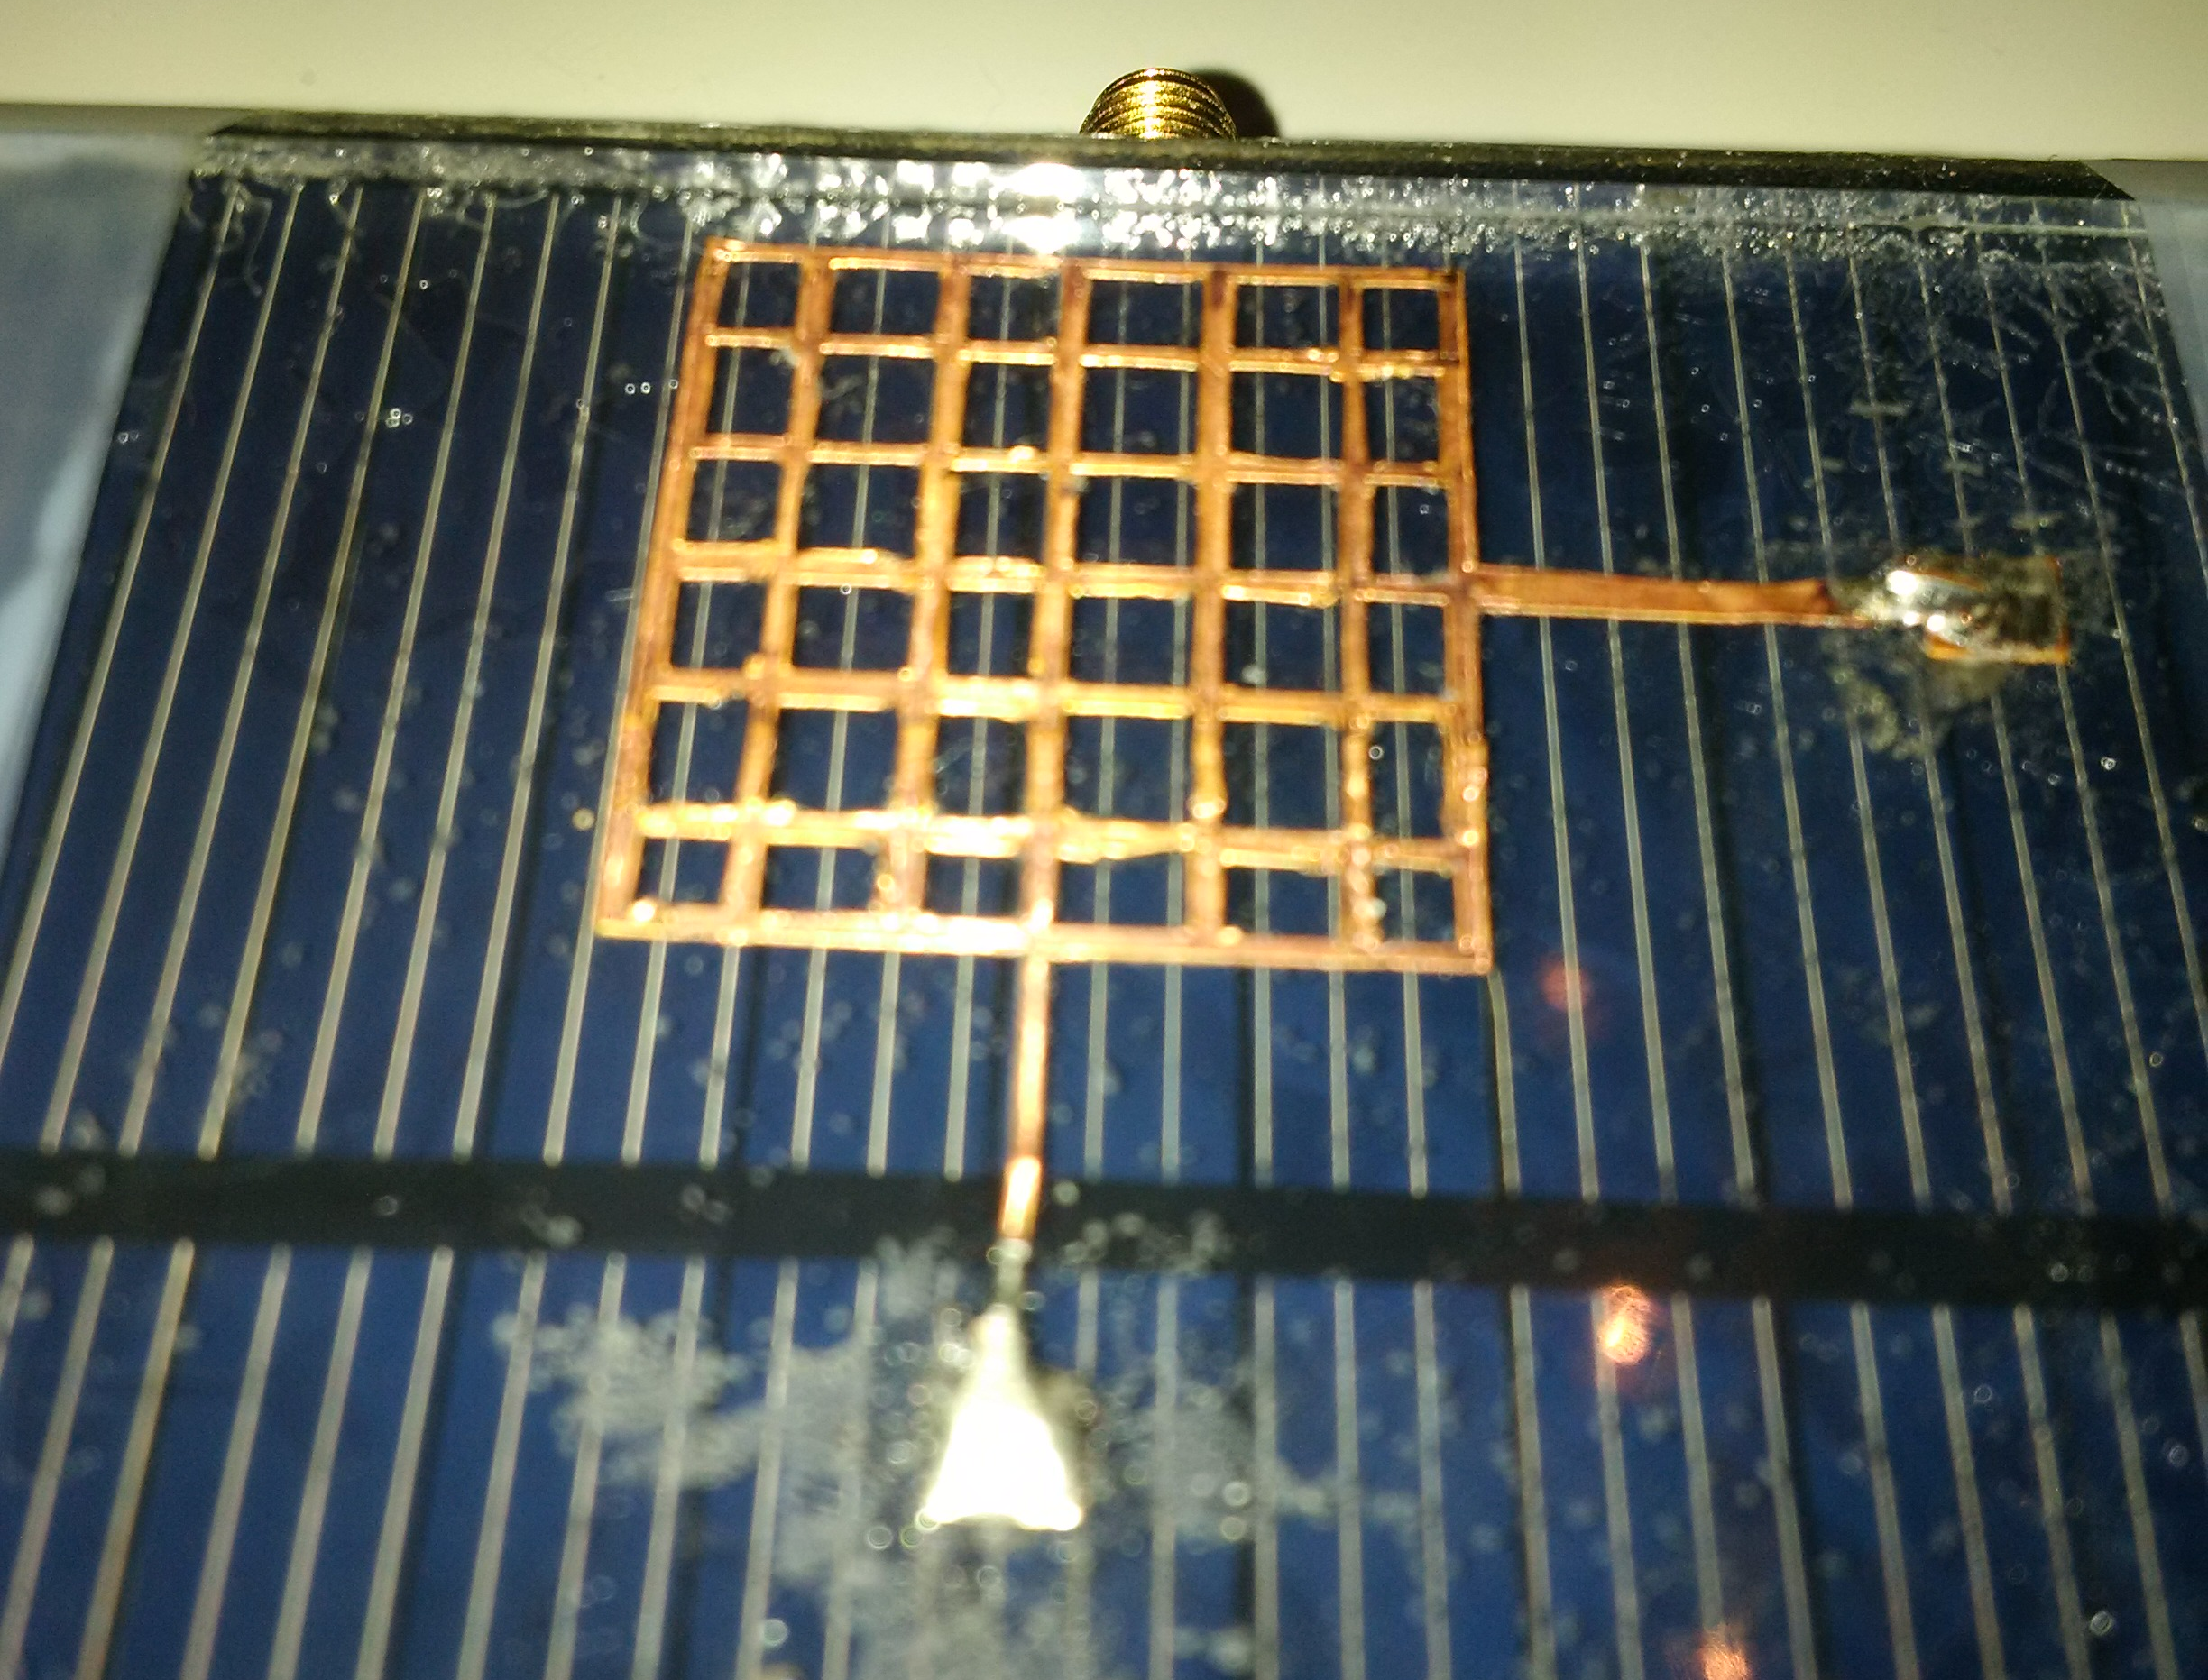
Potential applications & Collaborations
Low-cost technology for commercial applications
Less than 1 kg of weight → making it easier for anyone to launch a satellite.
use of 3D Printing, which has the potential to significantly reduce the manufacturing cost, total time for the design cycle, and material waste
Combinations of 3, 6 or 12 PocketQubes can carry out commercial applications.
Single cubes were developed as tools for teaching and technical demonstration.
But these larger, more powerful crafts offer new kinds of opportunities.
Earth Observation
Constellations of these crafts take more frequent images than traditional satellites.
One satellite can take up to 48hrs to fly back over the same site.
A swarm of 50 satellites would take an image almost every hour.
Capable of approximately 15m GSD @ 350km Orbit.
Can be upgraded to hit better specs
Look at different spectral bands.
Internet of Things Missions
Inter Satellite Links mission with STARA SPACE
R&D Collaborations
Integrating Antennas on Solar Panels
Propulsion system Integration
Deployable lens
05/09/2019
1

Slide 21
Potential applications & Collaborations
Baseline:
  Transparent-like antenna for end-fire radiation which can exploit a thicker substrate should it be needed.
Solar cell ~0.2mm + extra
Paint layers
Copper 35 μm
FR-4 0.4 mm
05/09/2019
<number>

Slide 22
Ham Radio Operators Challenges
First Person to track Unicorn2 satellite Call Sign
Down Load Telemetry/ Image from Unicorn2
Open Source Graphical User Interface (GUI) -Alba Orbital web.
05/09/2019
<number>

Slide 23
THANK YOU
<number>

