Slide 1
Advancing PocketQubes, Unicorn-2, Albapod and launch clusters
Tom Walkinshaw
15/10/2018

Slide 2
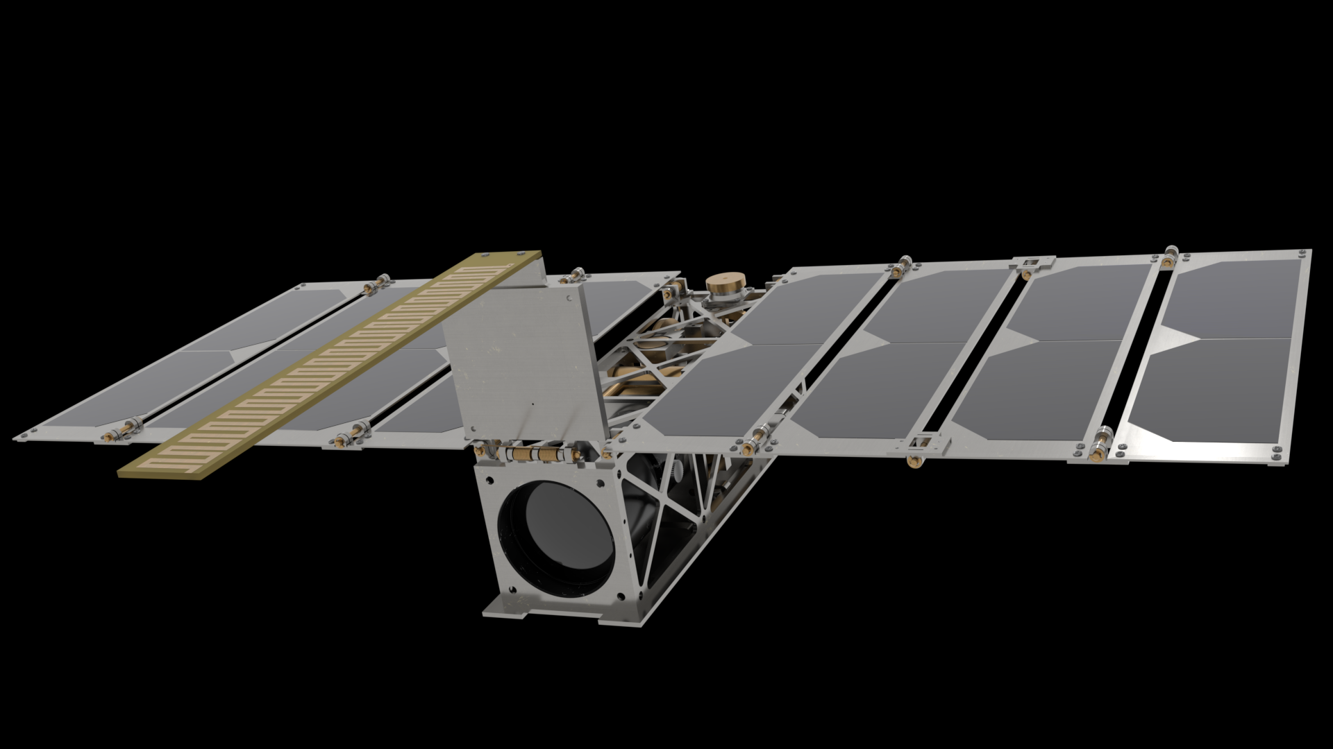
Mission Statement of Alba
Alba Orbital’s mission is to advance the PocketQube cause. Our goal is to be the best PocketQube company in the world and for that to matter.

Slide 3
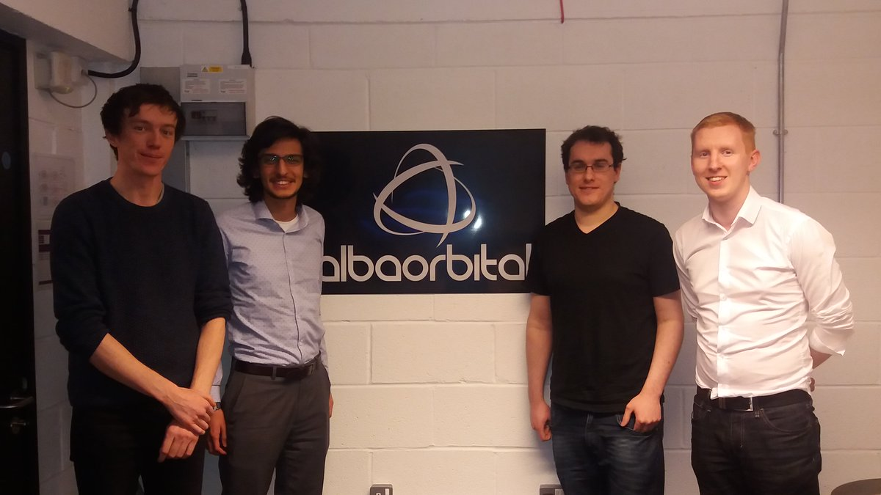
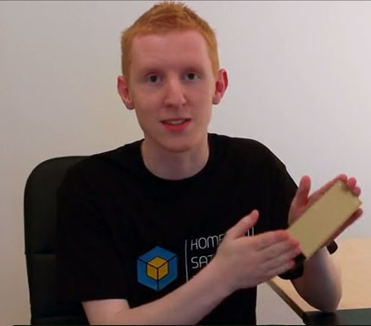
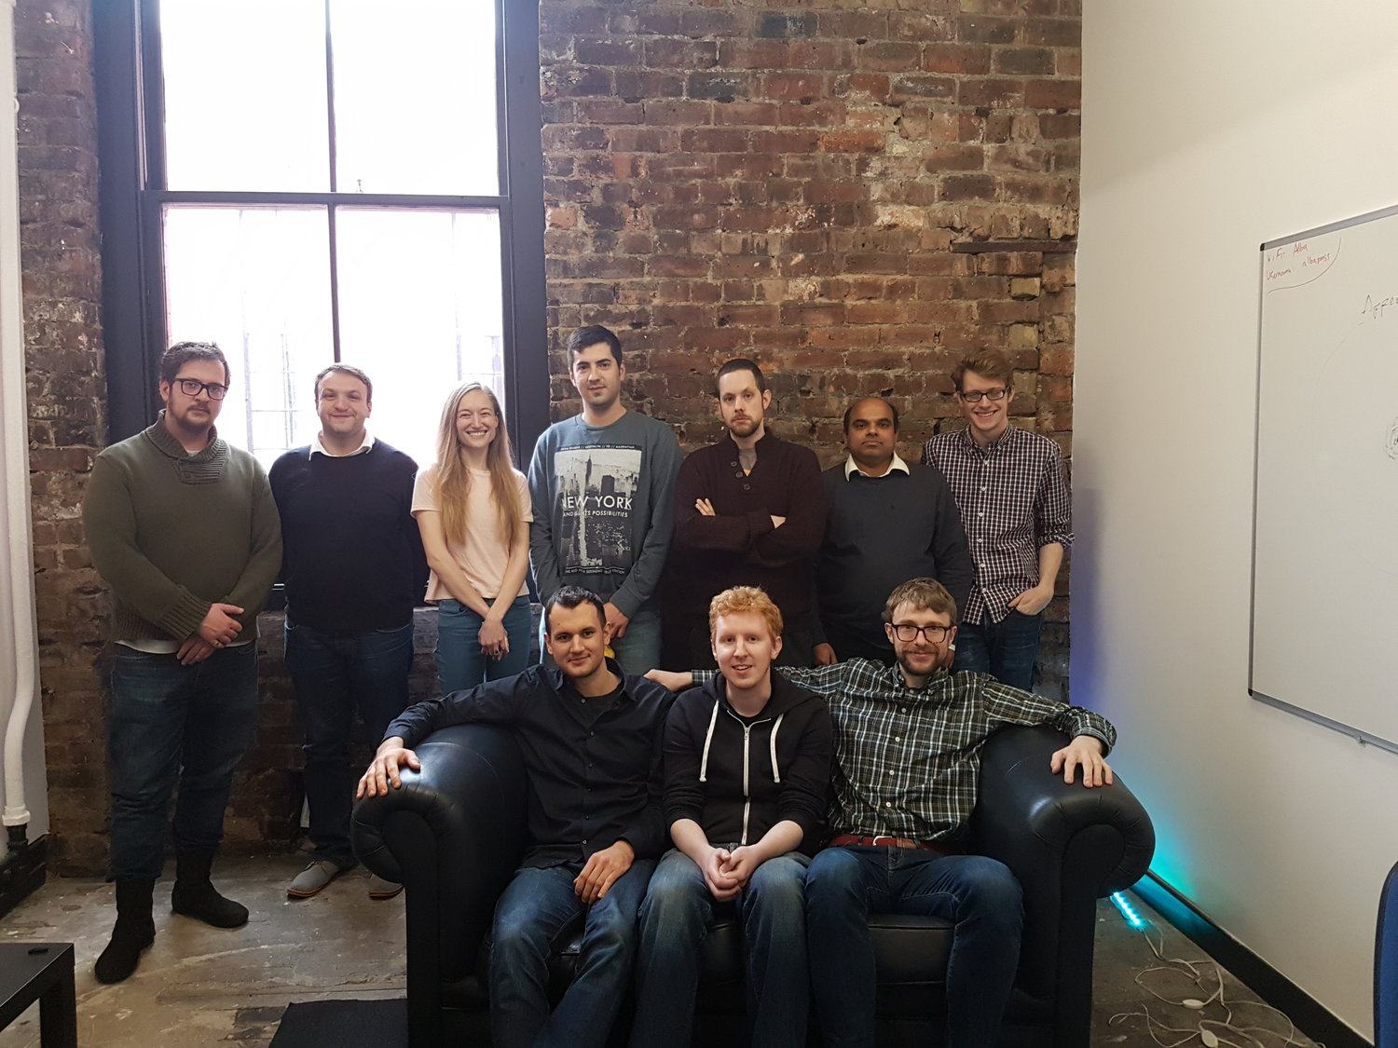
Team
2013
Team Size: 1
2015
Team Size:4
2018
Team Size: 15

Slide 4
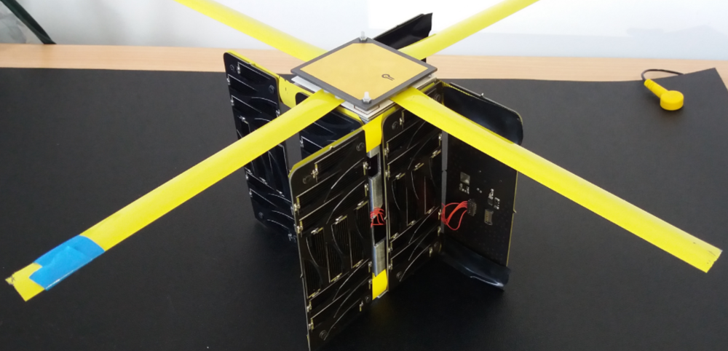
Unicorn-1
Alba Orbital’s first satellite
Ideal for first missions, student missions and testing in space (IOD)

Slide 5
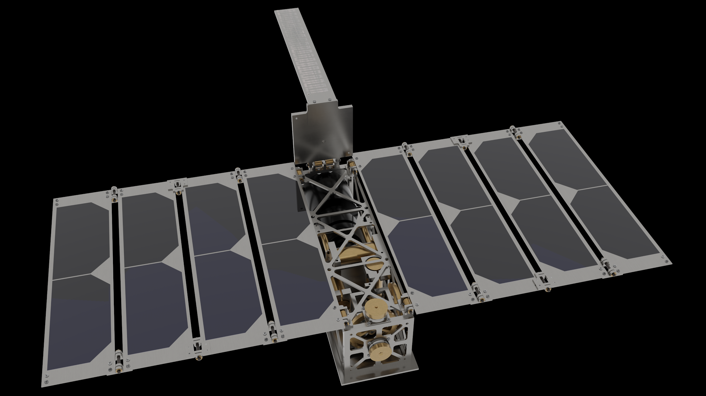
Unicorn-2
20 Watts of Power (Matches a 3U CubeSat)
Full service platform from concept to launch
Full adcs, UHF/S-BAND,
From €199k (free launch included til 31st of December)

Slide 6
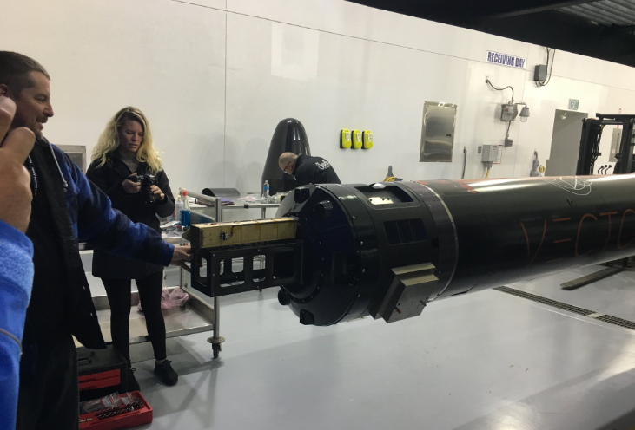
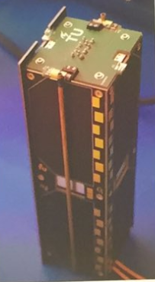
Cluster-1
Powered by the 6p AlbaPod, total 6p
March, 2019, Kodiak
Target ~350KM SSO, LTAN,
Soldout, Unicorn-2a (3p), DelfiPQ (3p)

Slide 7
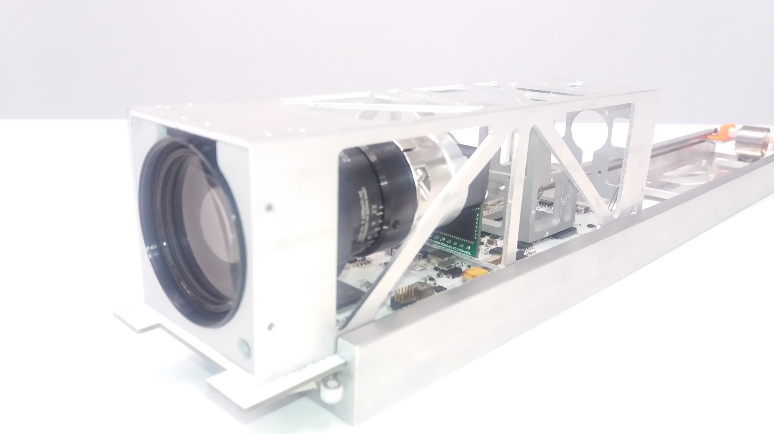
Unicorn-2a

Slide 8


Slide 9
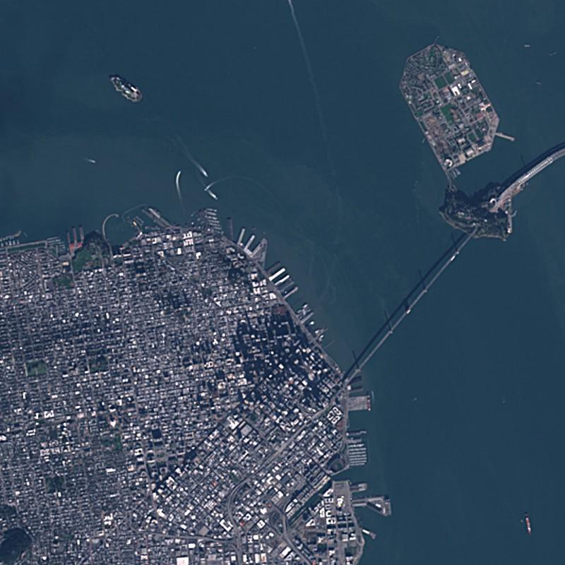

Slide 10
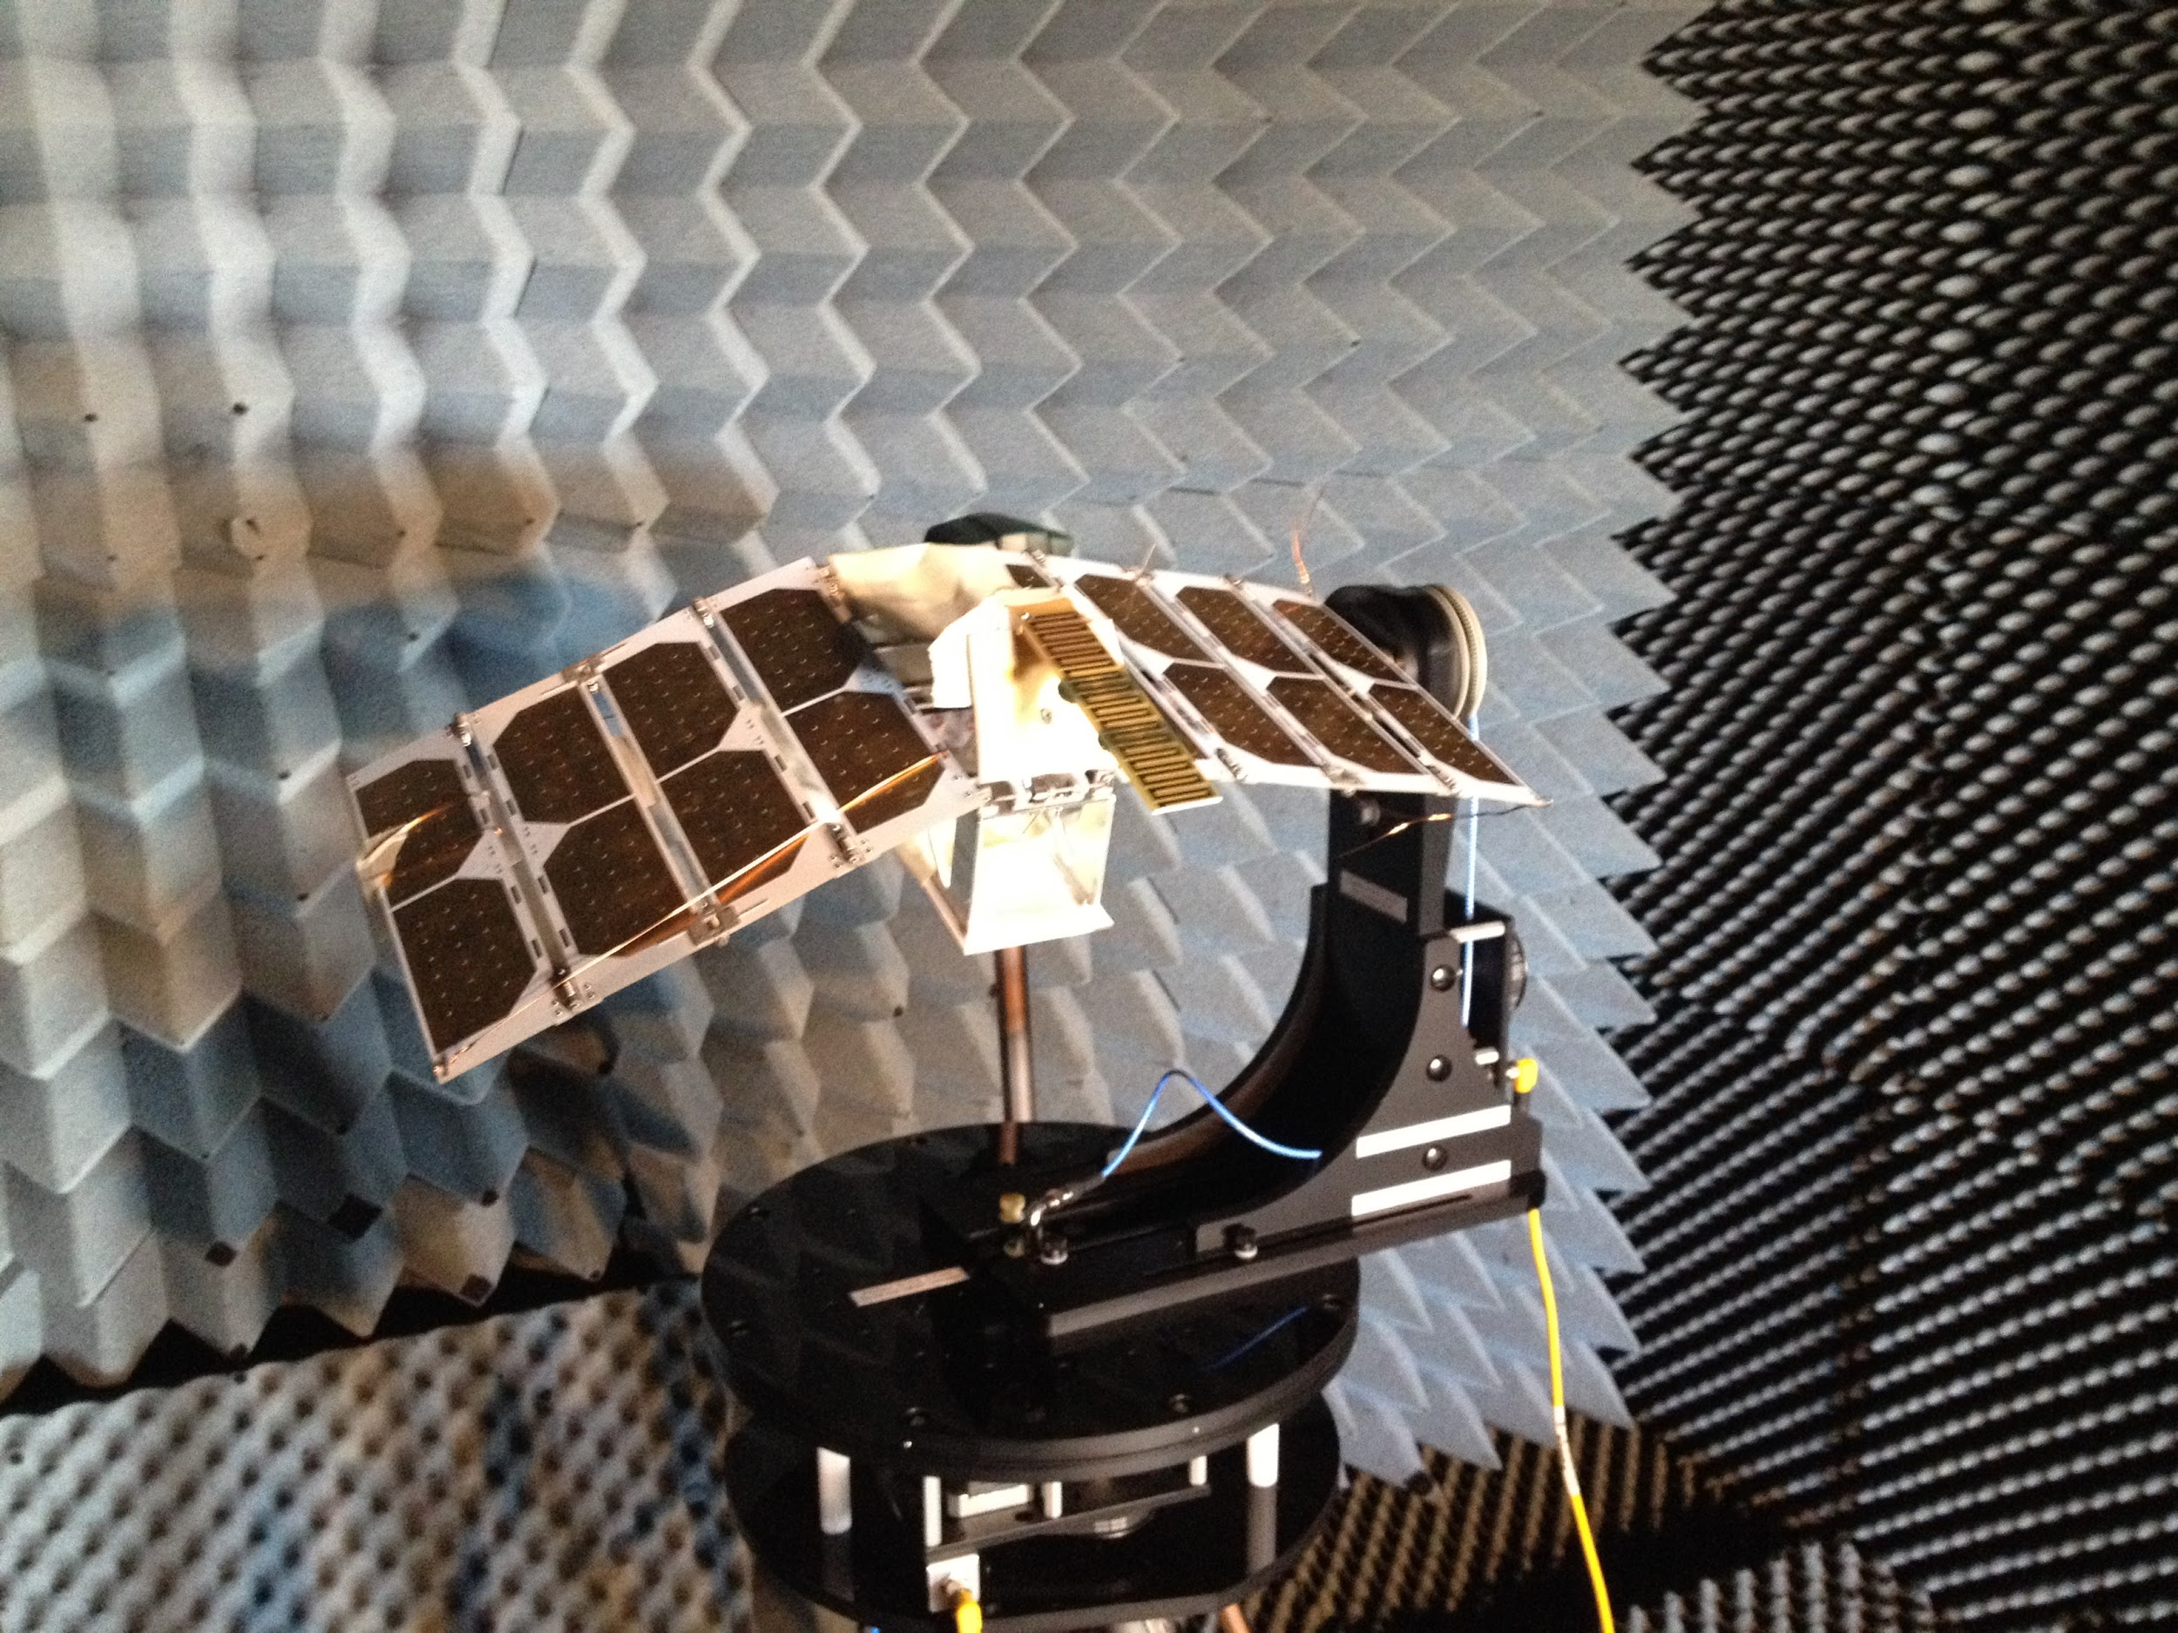
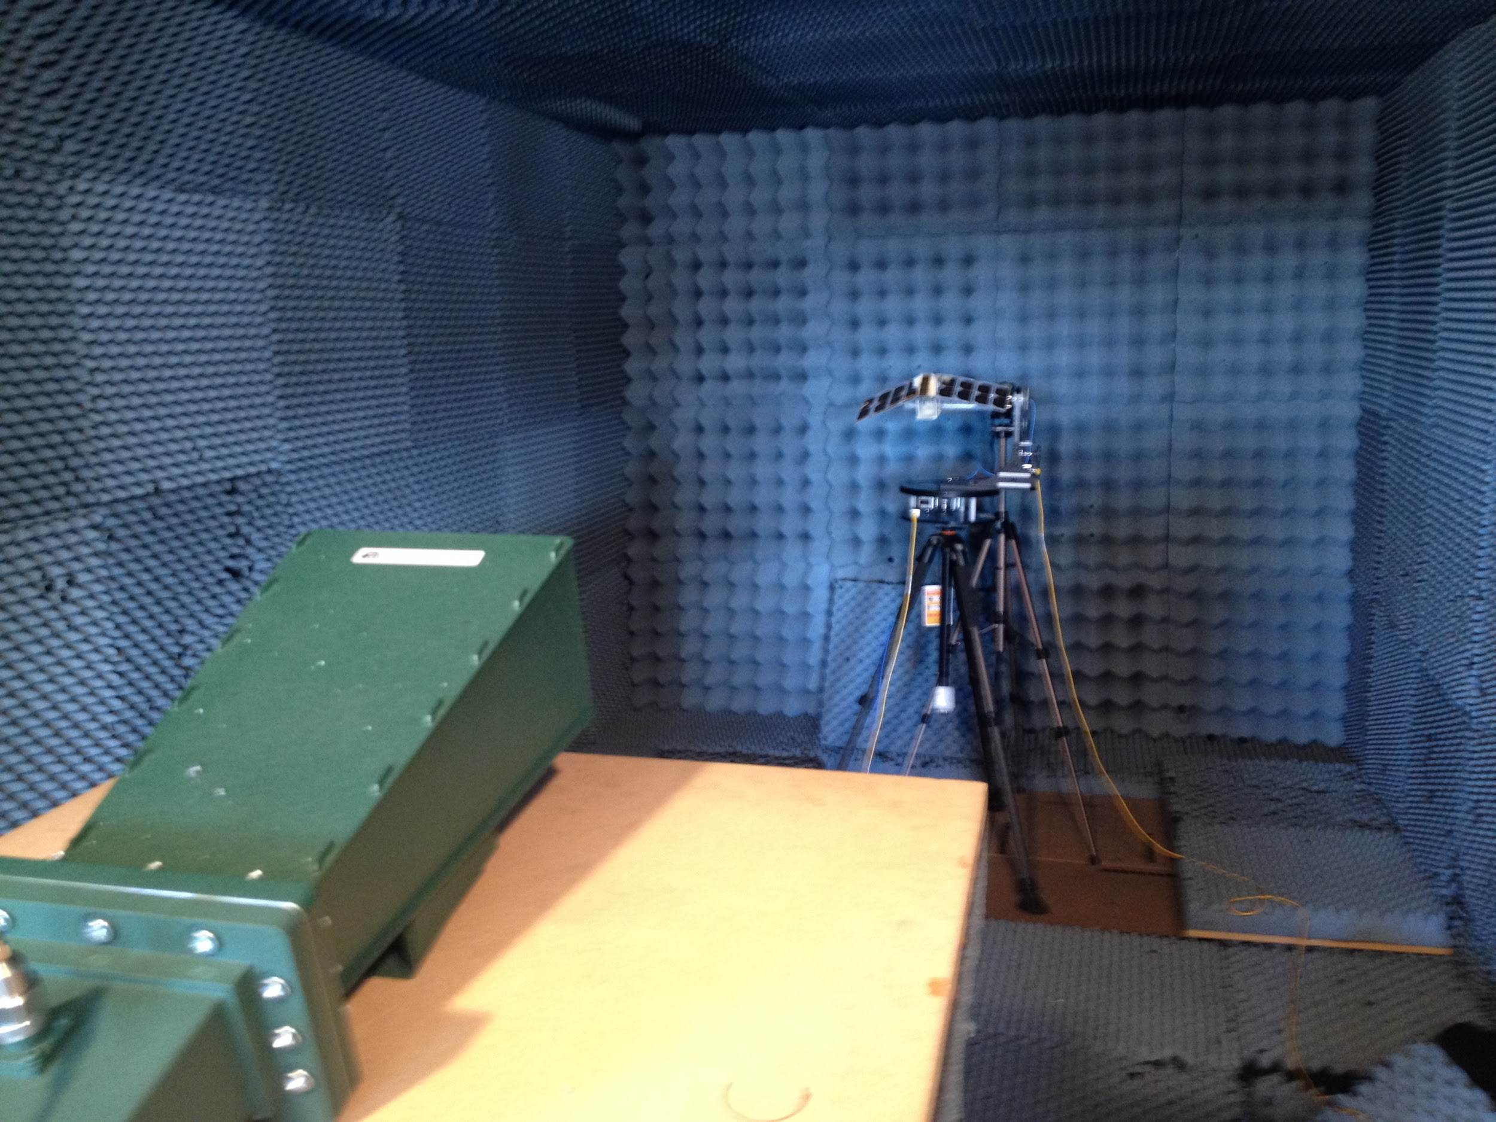

Slide 11
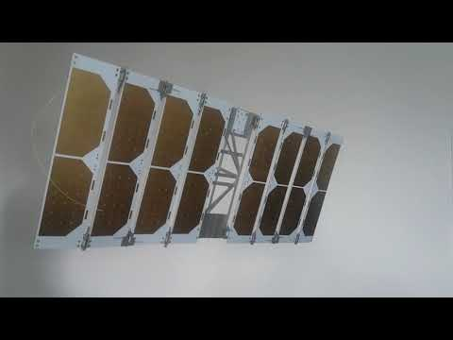

Slide 12
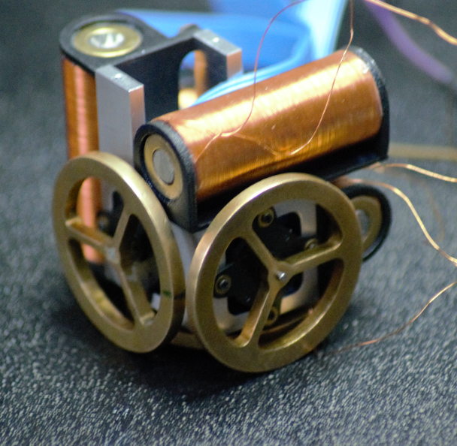
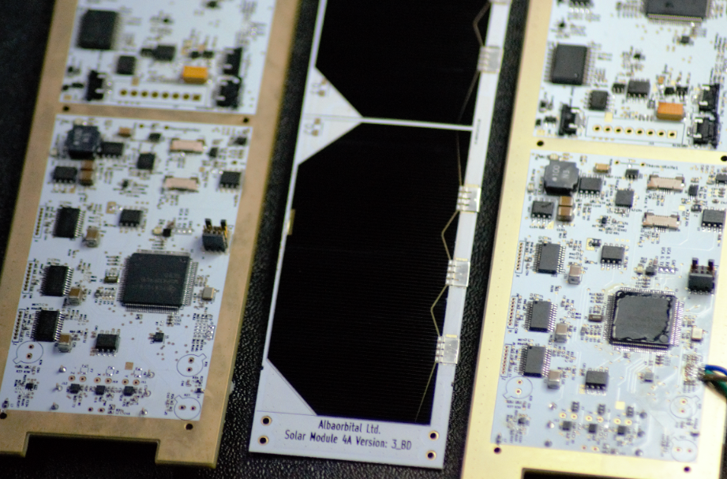

Slide 13
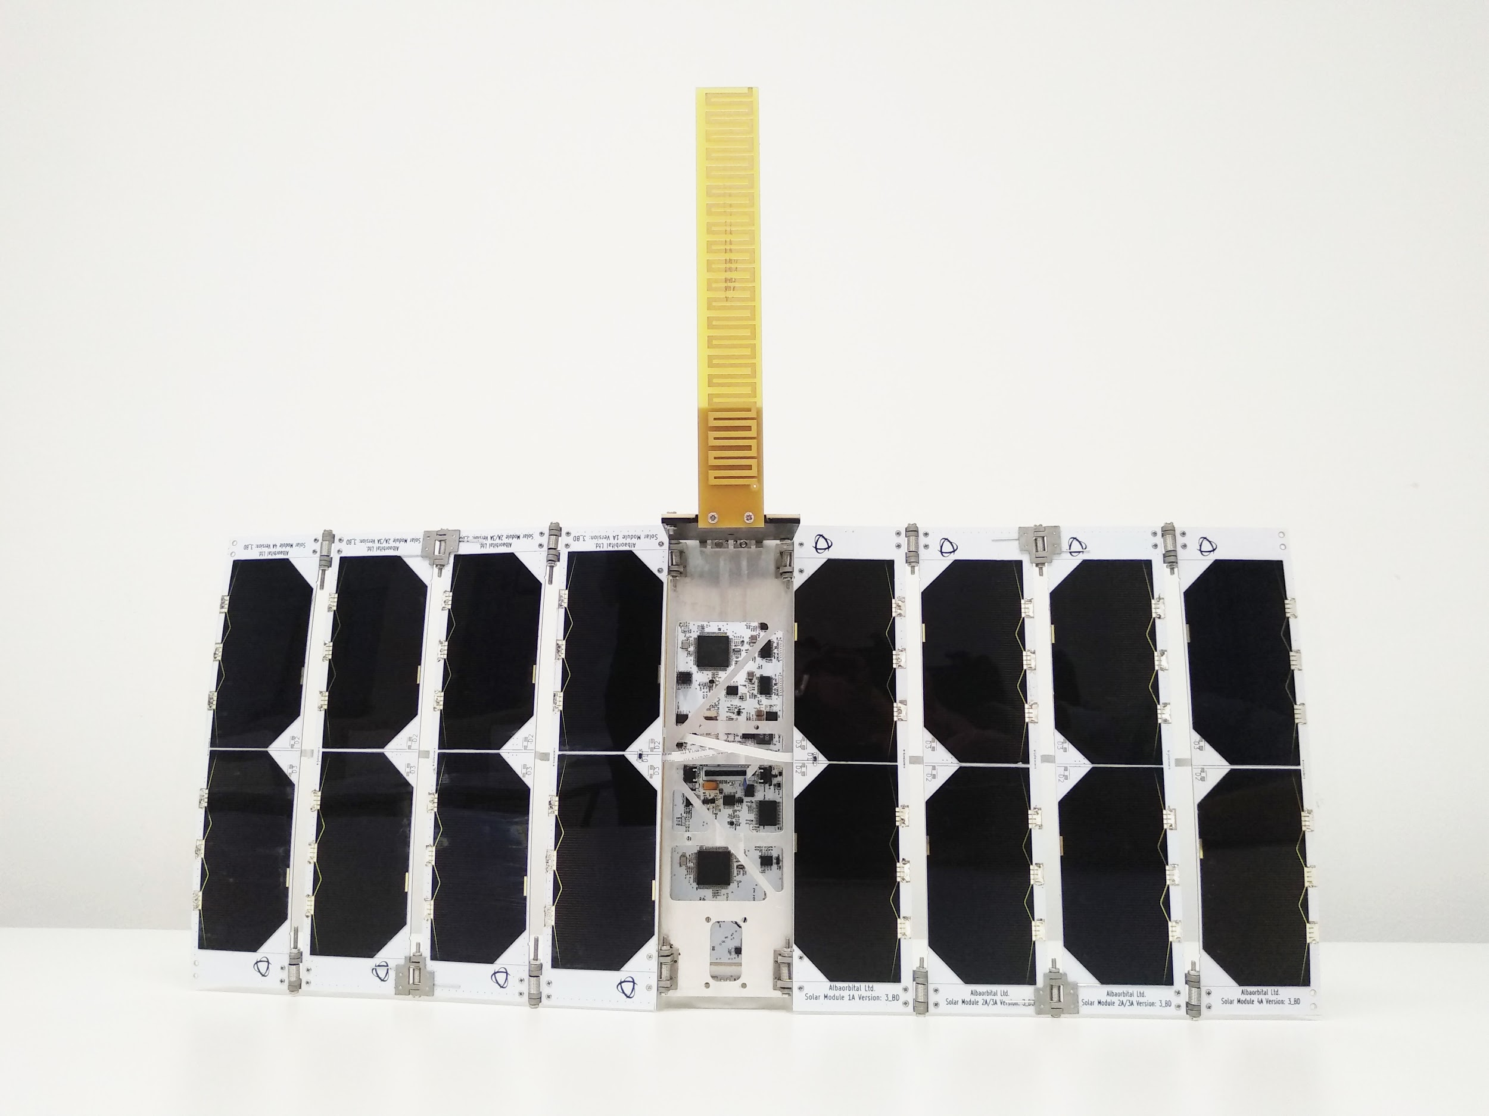

Slide 14
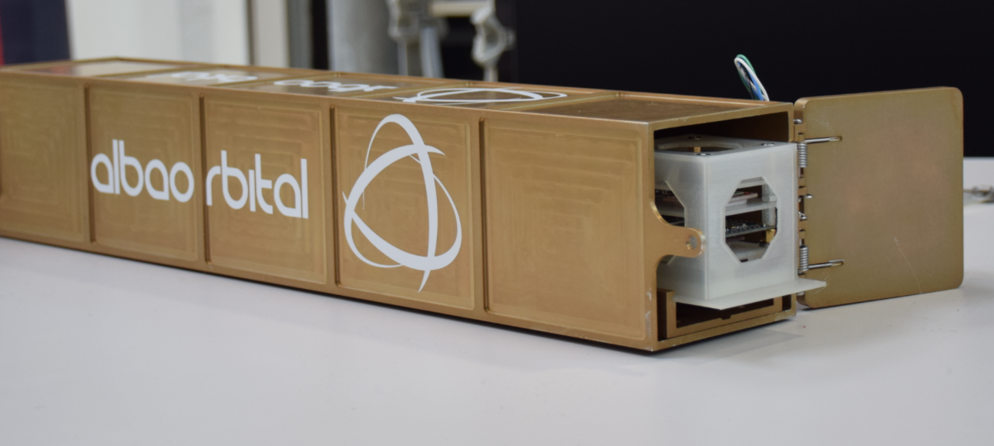
Cluster-2
Powered by the 6p AlbaPod, total 12p
Mid, 2019
Target ~385KM SSO, 20:30 LTAN, TBA LV
1p - €25K, 2p - €40k, 3p - €60k, 6p sold, 6p available

Slide 15
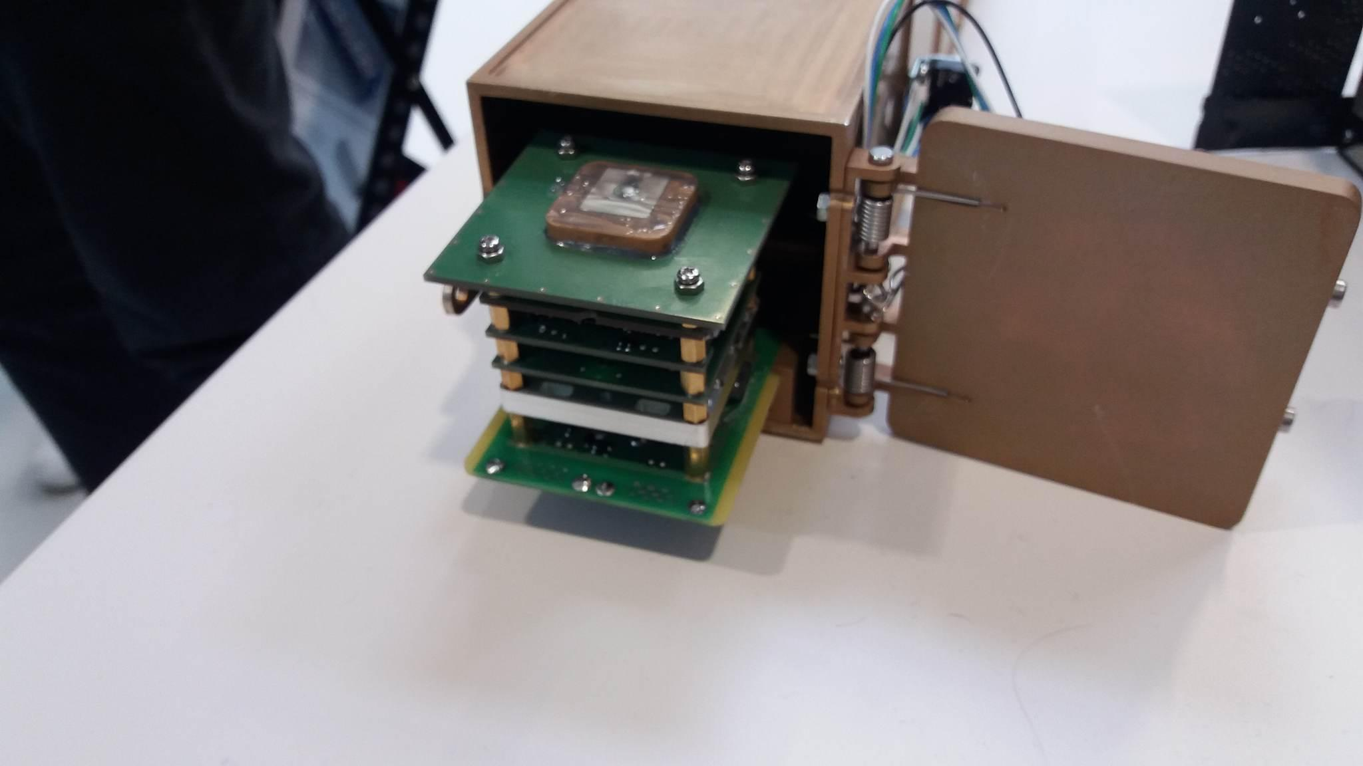
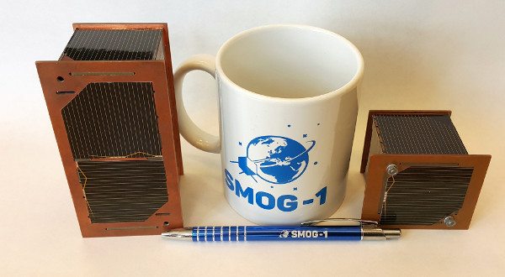

Notes:
Cluster 2 Customer (excluding Croatia sat)

Slide 16
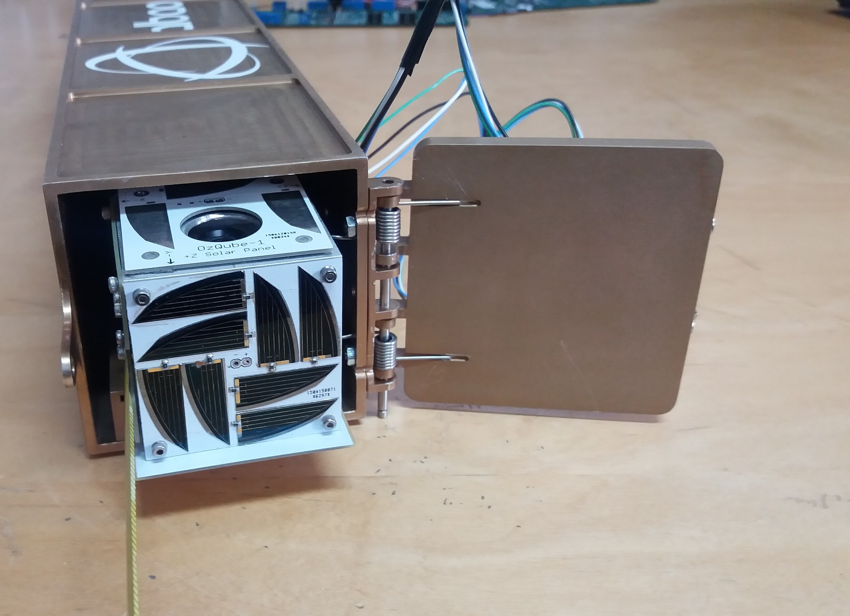
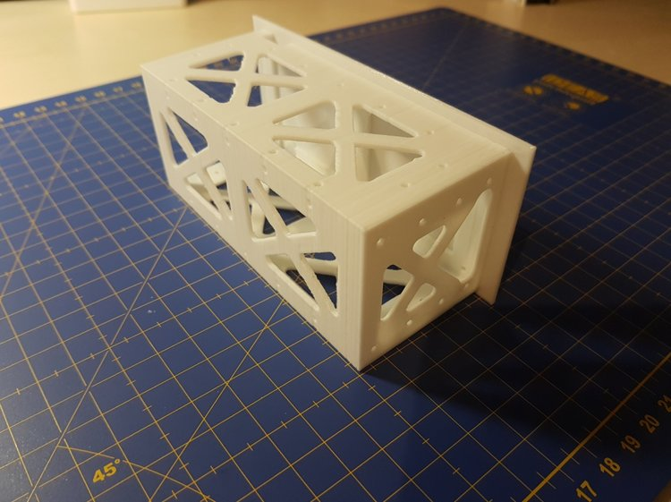
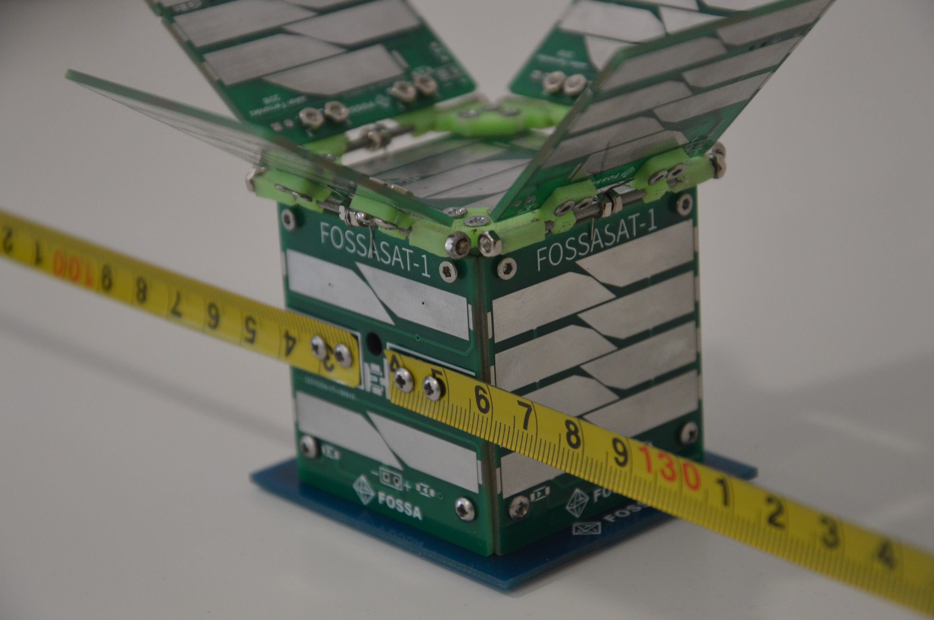
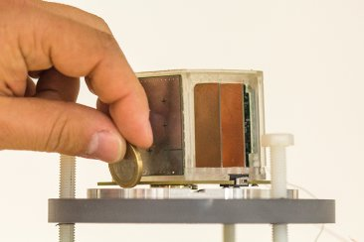

Slide 17
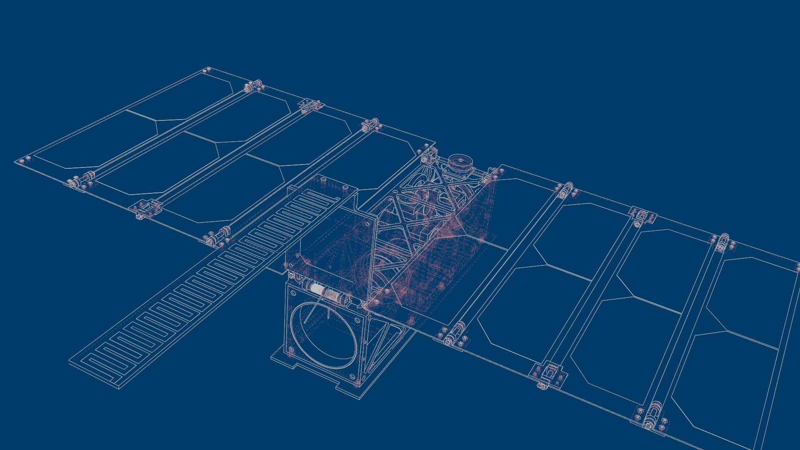
Great Things about Going Small:
In General :
Cost
Launch Opportunity (March of the Small Launchers)
Constellation
Allows the collection of new datasets
PocketQubes:
Full ADCS System (Target 5 degrees)
Payload space
Annual launch service
Lots of power
PQ Standard

Slide 18
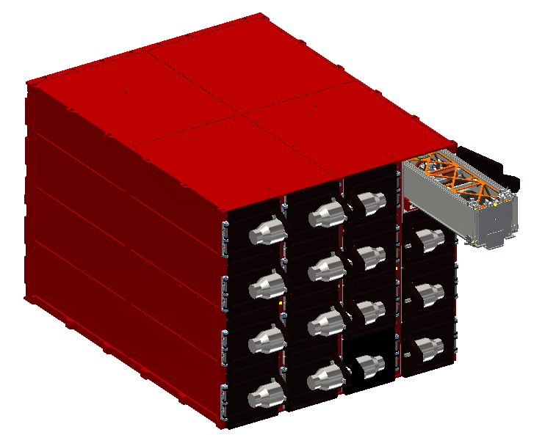
96P POD design

Slide 19
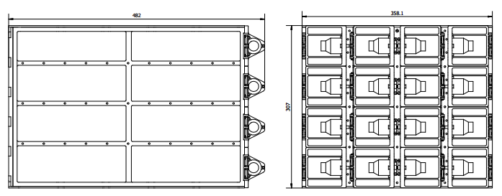
96P POD
Large 96p swarm deployer
32 Unicorn 2 capacity
ESA supported development
Underwent CDR review
Dry mass 17.71kg (41.71kg loaded with 32 Unicorn 2)

Slide 20
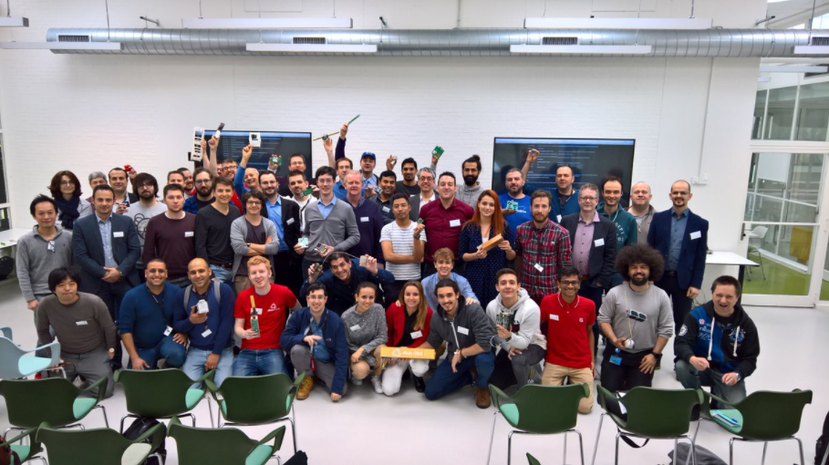

Slide 21
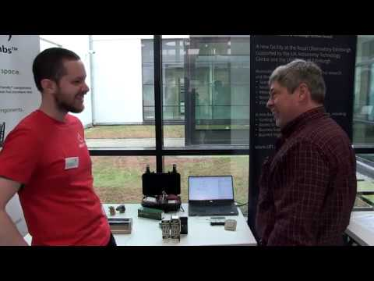

Slide 22
contact@albaorbital.com

Slide 23
Discussion Time

Slide 24
Looking for an institute to host/run 2nd Asian PQ Workshop
Welcome input how to grow the community in the region

