Slide 1
Electrical Power Subsystem development
of Nepal-PQ1
1st Asian PocketQube Workshop
Singapore
Yaju Rajbhandari
EPS team, ORION Space
yazu.raz007@gmail.com
www.orionspace.com.np
November 5, 2018

Slide 2
Outline
Basic layout to EPS
Component to build the system
Test/Working with the components
PCB Design

Slide 3
Basic layout
Payload
PV CELLS
Current Sensor
MPPT Charger/
Charge controller
Battery

Slide 4
Components
PV panel
5 faces with 8 cells each.
Charging Circuit
3 SPV 1040 based MPPT
Battery
CAS.NP-40

Slide 5
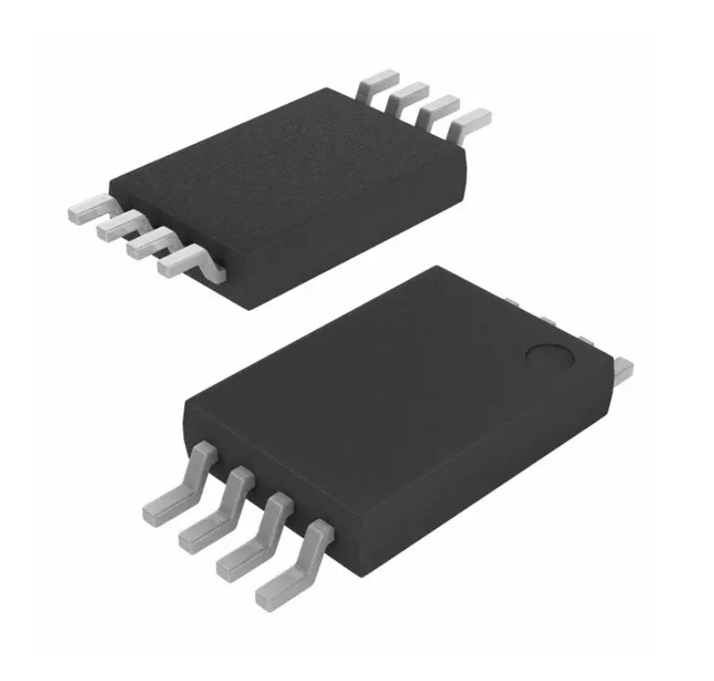
Spv1040 High efficiency solar battery charger with embedded mppt
Key Features
0.3V to 5.5V operating input voltage
Output voltage regulation, overcurrent and over temperature protection
Up to 95% efficiency

Slide 6
PV CELLS Currently working with test of charging circuit
Specifications:
Voc=2.2V
Isc=220mA
Vmp=1.92V
Imp=200mA
Pmp=400mW
Efficiency=11.1%
Dimension=60*60*2.5

Slide 7
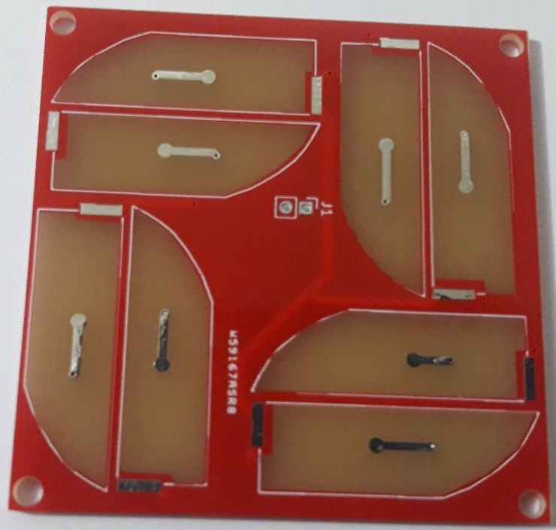
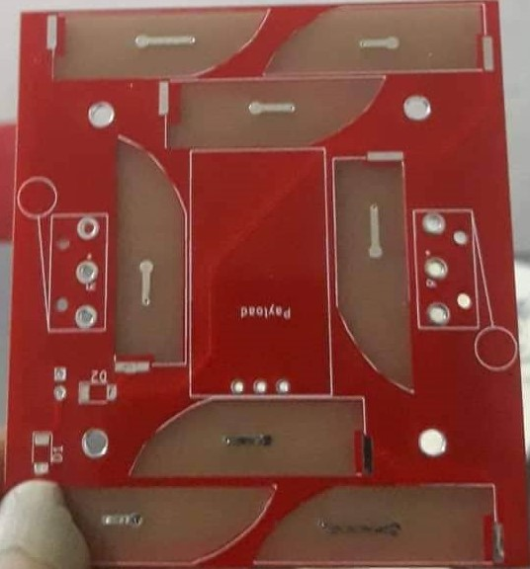
PV CELLS
Trisolx Specifications:
Voc=2.62V
Vmp=2.33V
Imp=14.6mA
Pmp=34mW
Efficiency=28%
Dimension=8*26.3*0.16
From TrisolX
Total = 8*14.6 =116.8 mA

Slide 8
Battery Pack
CAS.NP-40
Lithium-ion
3.7V
1600mAh
Camera Battery
Battery with Protection Circuit
Battery Protection Circuit
Battery without Protection Circuit

Slide 9
Development Status of EPS

Slide 10
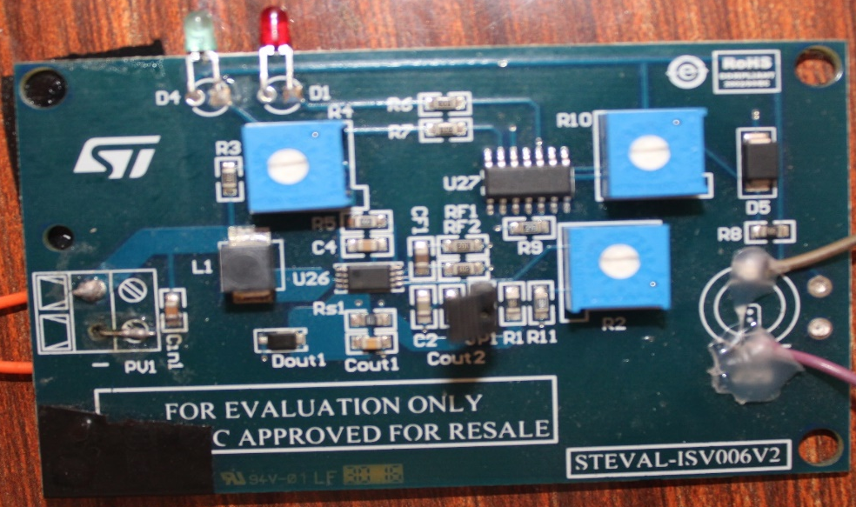
Development Boards
STEVAL-ISV006V2
STEVAL-ISV012V1
SPV1040 based battery charger with battery charge control circuit.
SPV1040 based battery charger with L6924D charging circuit, having three charging modes:
Pre-charge constant current
Fast-charge constant current
Constant Voltage

Slide 11
Battery Charger
Maximum current observed using this board was 75mA using 60*60 solar panel.

Slide 12
Battery Charger

Slide 13
Battery discharging
Using a resistor of around 7ohm as a load to draw current in the range of 500mA, considering the extreme case.

Slide 14
Prototyping
INA219 Prototyping Board
EM v1 Prototyping Board

Slide 15
Thank You!!!!

